Slide 1
Smart Event
Centralized Event Coordination Platform

Slide 2
Table of contents
01
02
03
04
05
Introduction
Objectives
Functional Requirements
06
Non-Functional Requirements
Project’s Diagrams
Project Visualization

Slide 3
Introduction
Why Smart Event?
Event organization in universities is often decentralized and inefficient.
Communication gaps, booking conflicts, and poor task tracking cause delays.
What is Smart Event?
A web-based platform to centralize and streamline event management.
Supports students, faculty, and admins to coordinate events.
Improves communication, scheduling, and transparency.

Slide 4
Objectives:
Centralize event proposal, approval, and execution.
Provide role-based dashboards (Organizer, Department Admin, Logistics, Volunteers).
Manage venue booking, resource allocation, and task assignments.
Track events live and gather post-event feedback & reports.
Foster collaboration and enhance student engagement.

Slide 5
Functional Requirements
System Capabilities:
User Management: Registration, Login, Roles, Permissions, Profile Updates.
Event Lifecycle: Proposal submission, approval, live status tracking.
Venue & Resource Booking: Conflict-free scheduling.
Task Coordination: Assign, track, and complete tasks with reminders.
Volunteer Management: Registration and assignment.
Document & Media Upload: Budgets, banners, galleries.
Notifications: Email and in-app alerts.
Reports & Analytics: Dashboards with event stats and exports.

Slide 6
Non-Functional Requirements
Performance:
Pages load within 2s; Calendar updates ≤3s.
Usability:
New users complete onboarding in ≤10 minutes.
Tooltips, guides, and error feedback built-in.
Maintainability:
Modular codebase with ≥70% backend test coverage.
Scalability:
Supports 200+ concurrent users and up to 1M records.

Slide 7
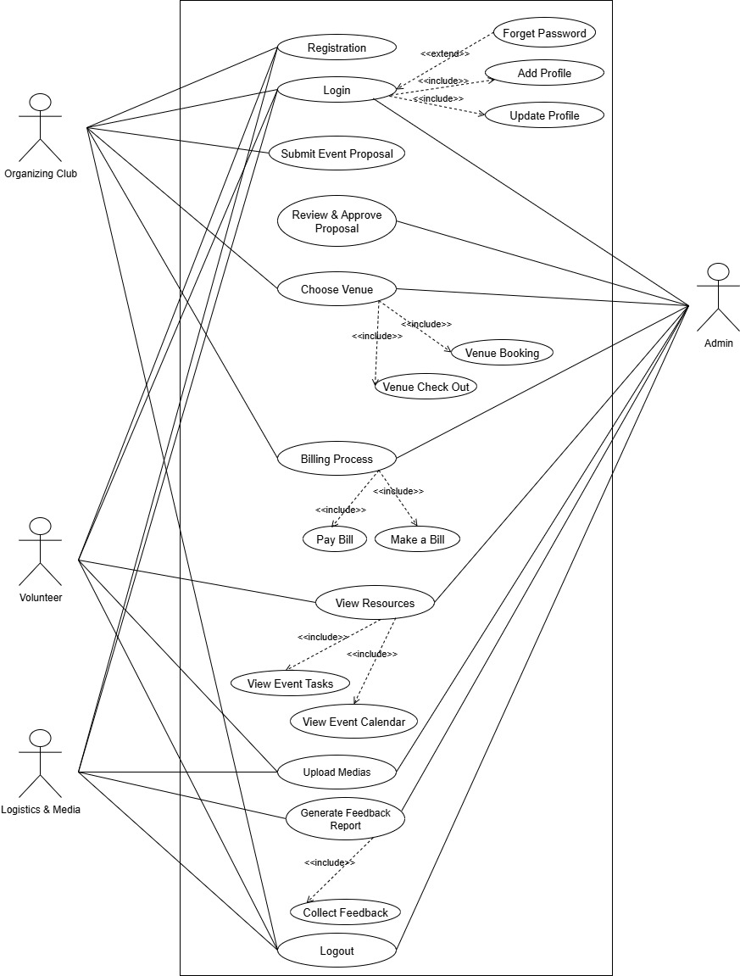
Use Case Diagram

Slide 8
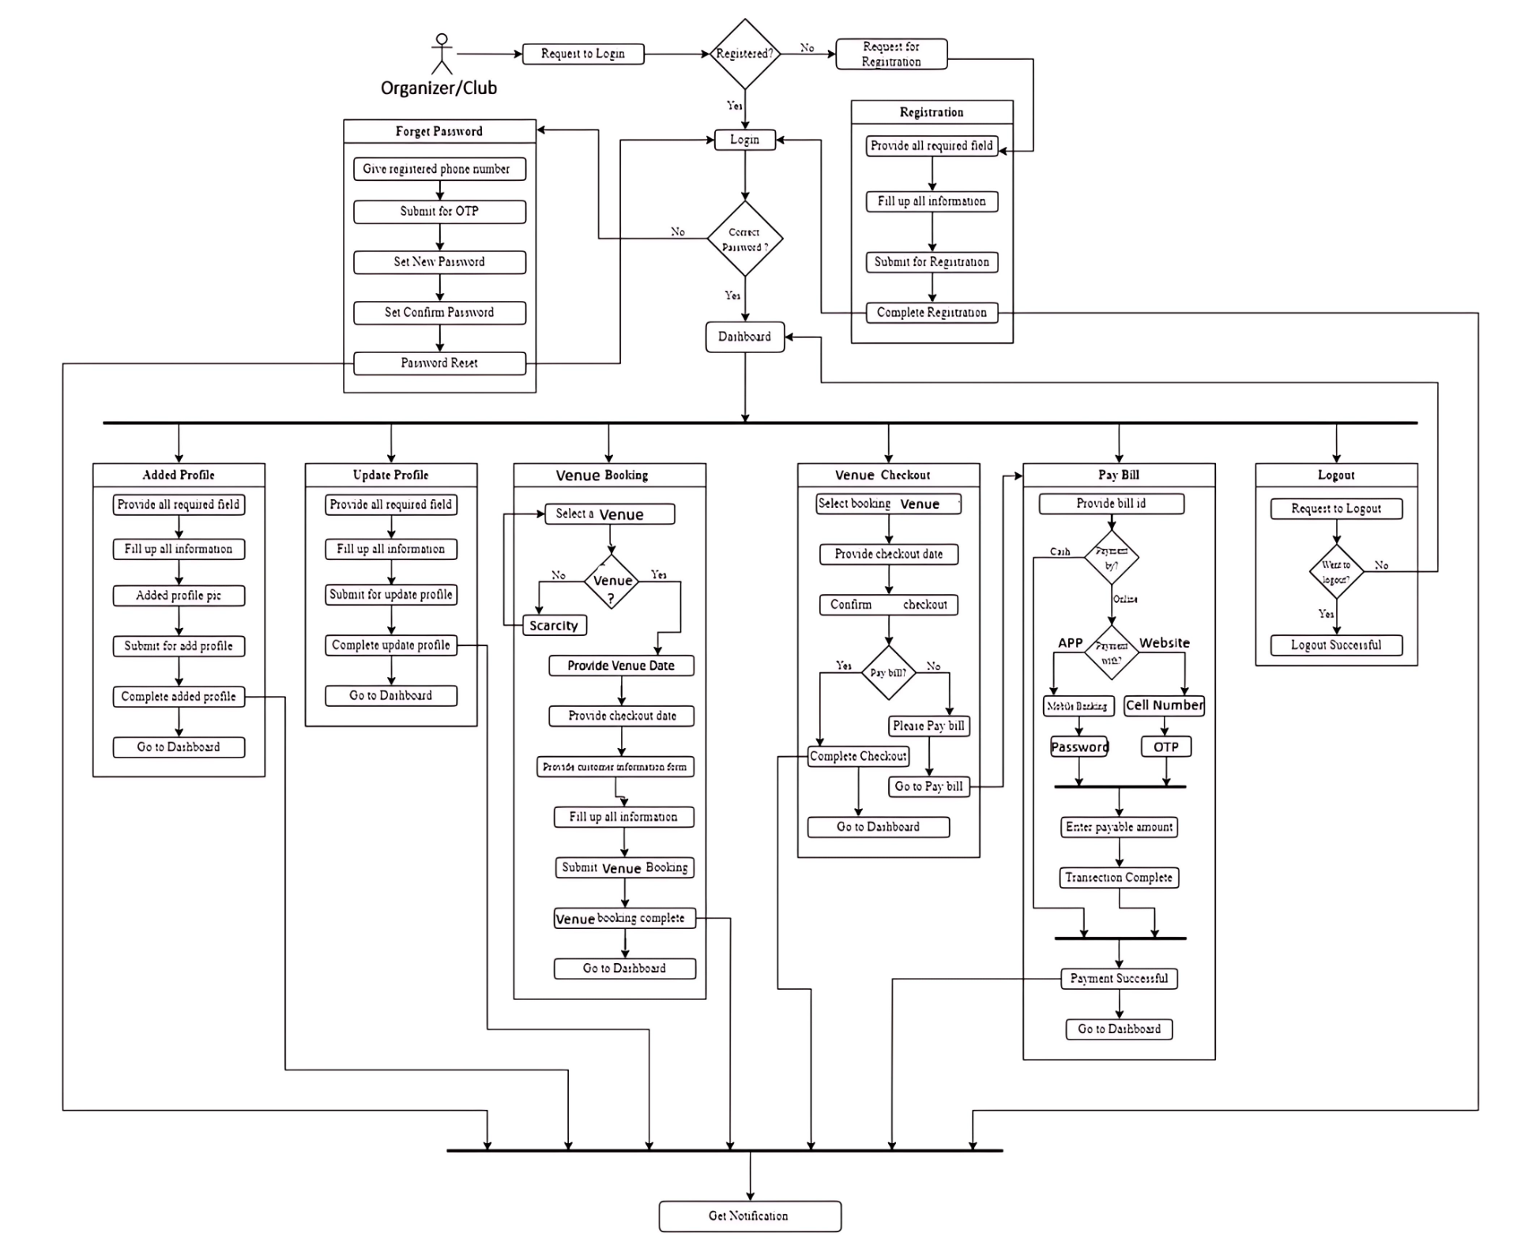
Block Diagram
01 : Organizer

Slide 9
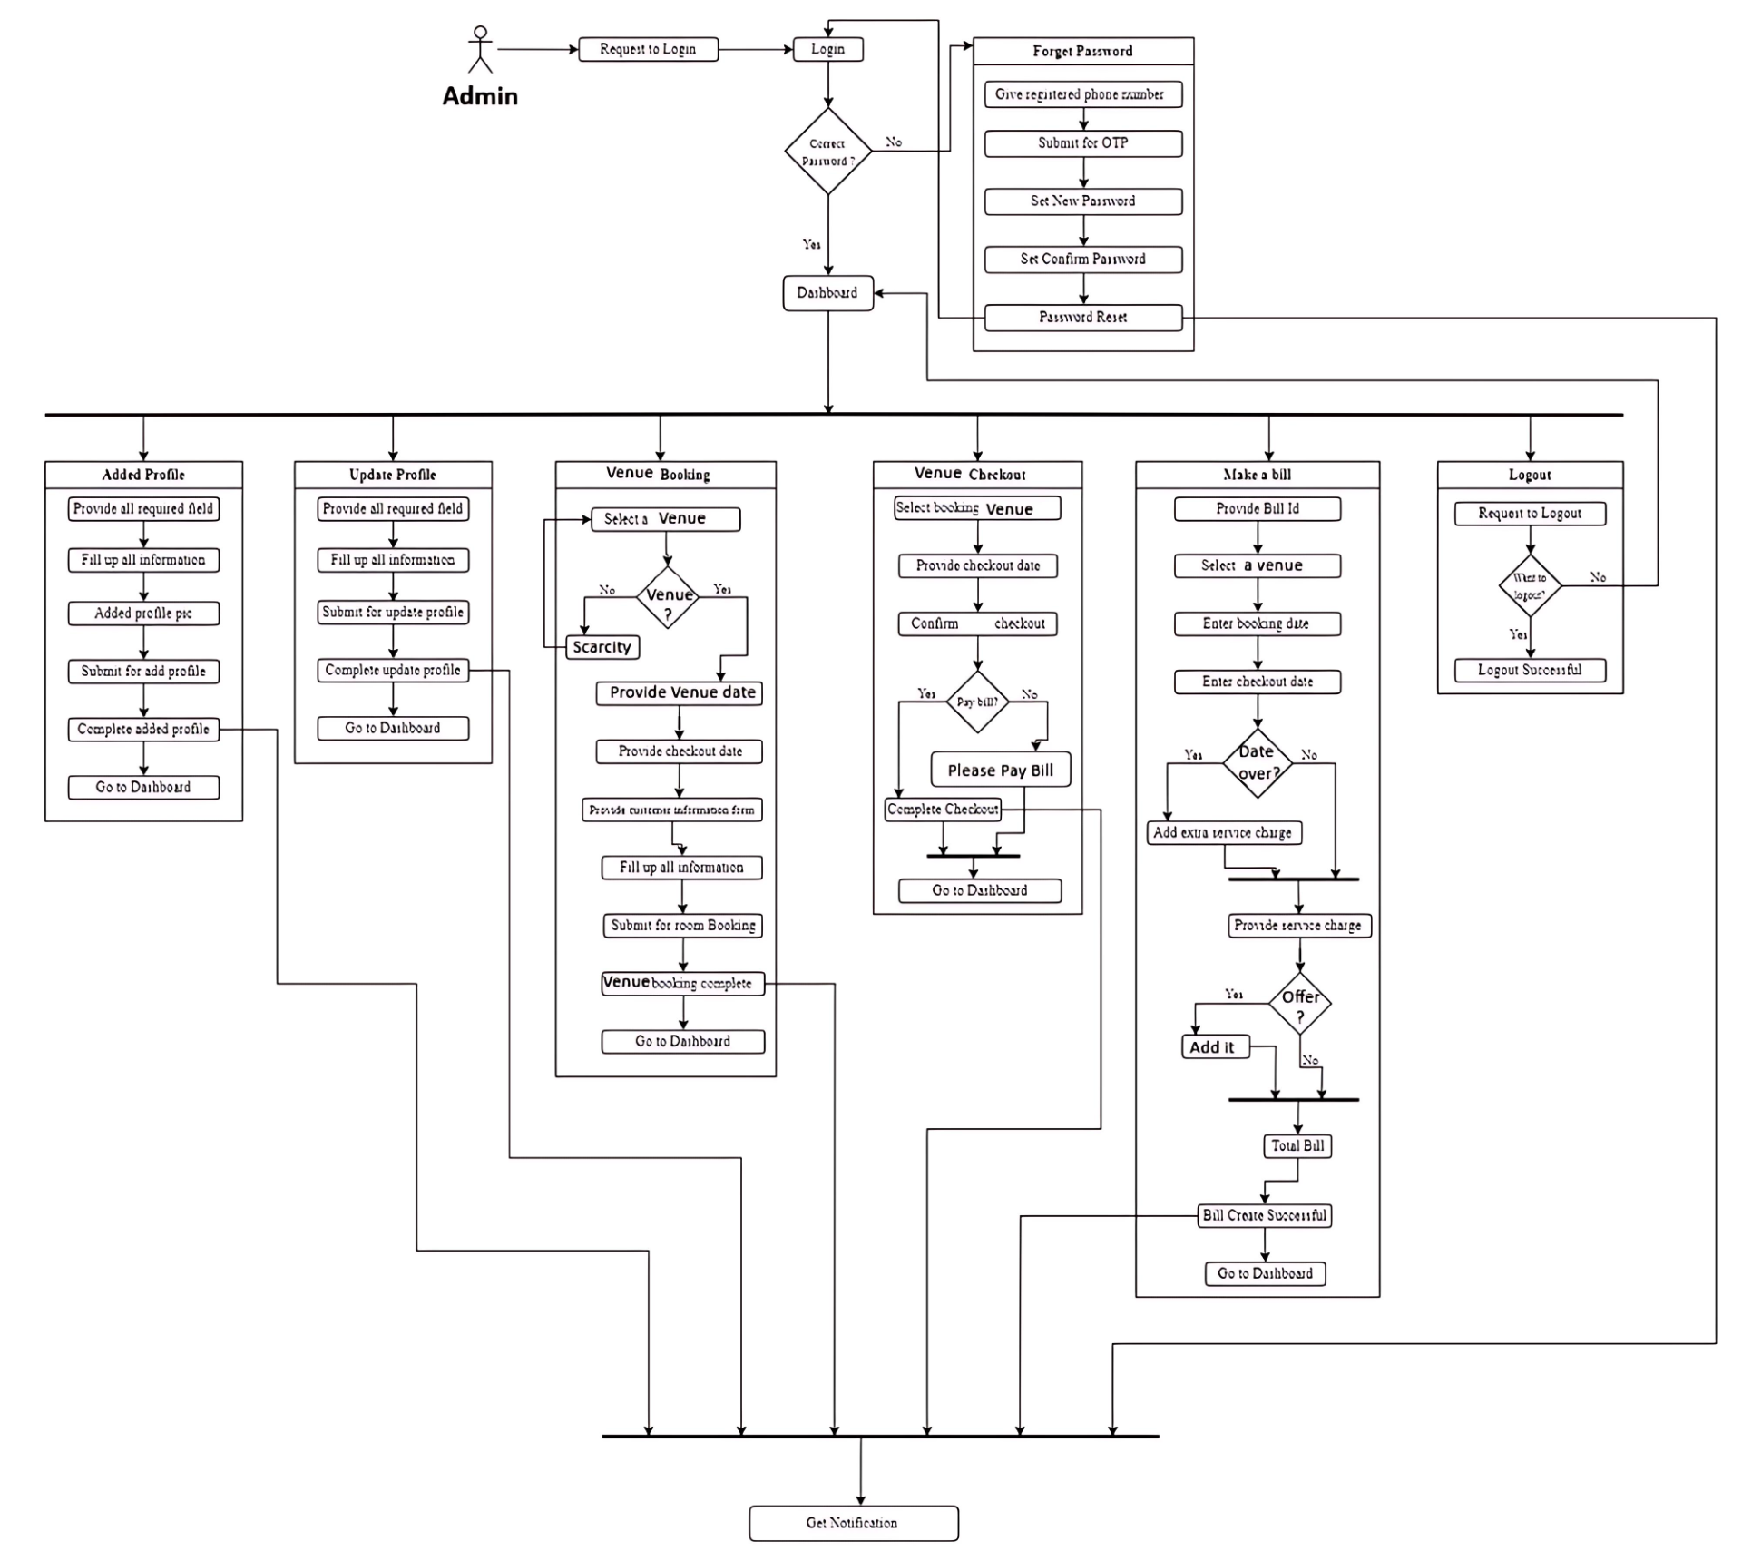
Block Diagram 02 : Department Admin

Slide 10
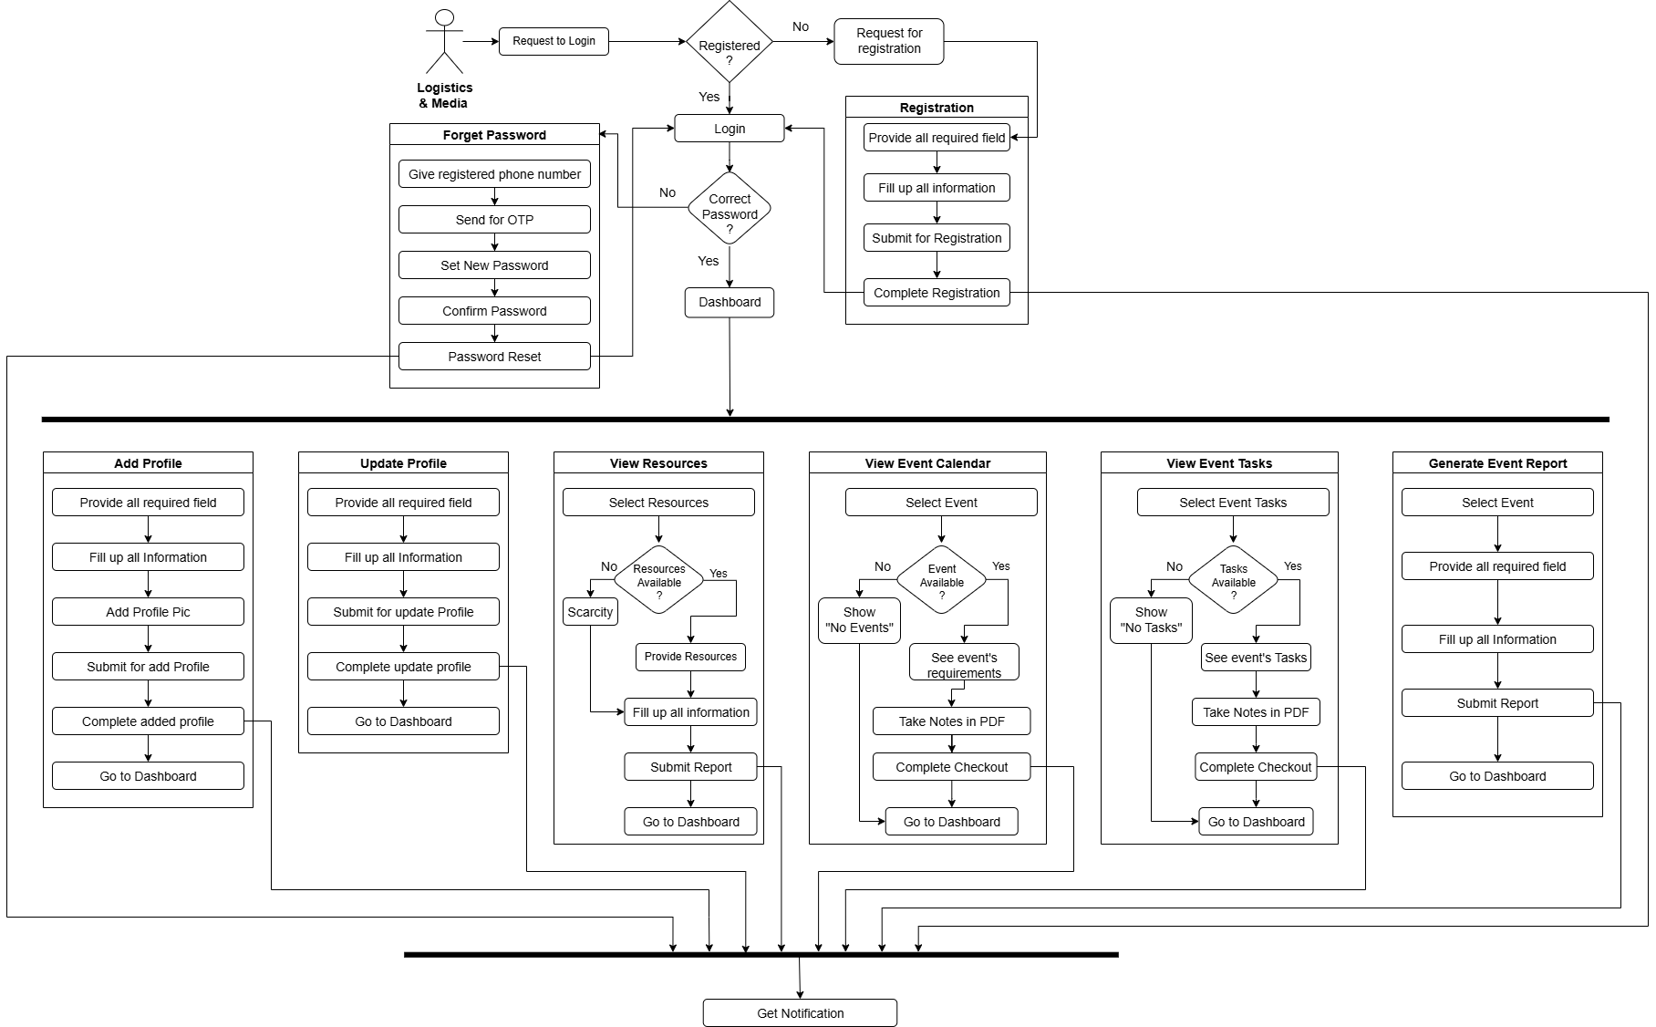
Block Diagram 03 : Logistics & Media

Slide 11
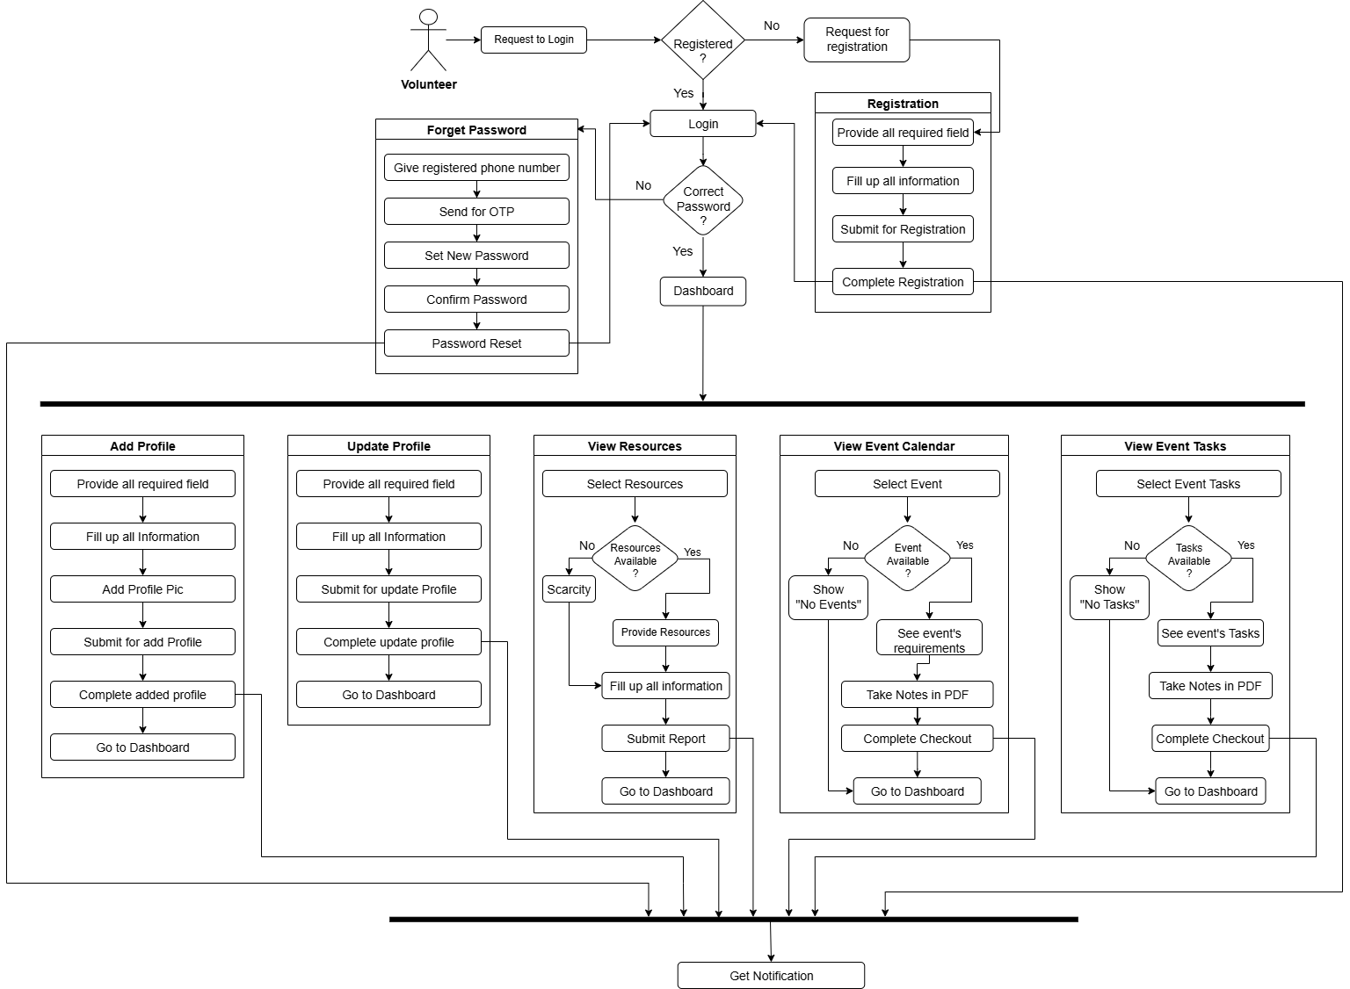
Block Diagram 04 : Volunteer

Slide 12
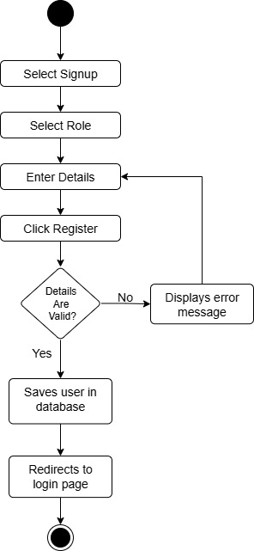
Activity Diagram - 01: Registration

Slide 13
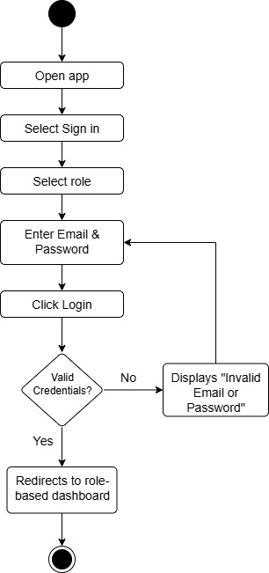
Activity Diagram - 02: Log In

Slide 14
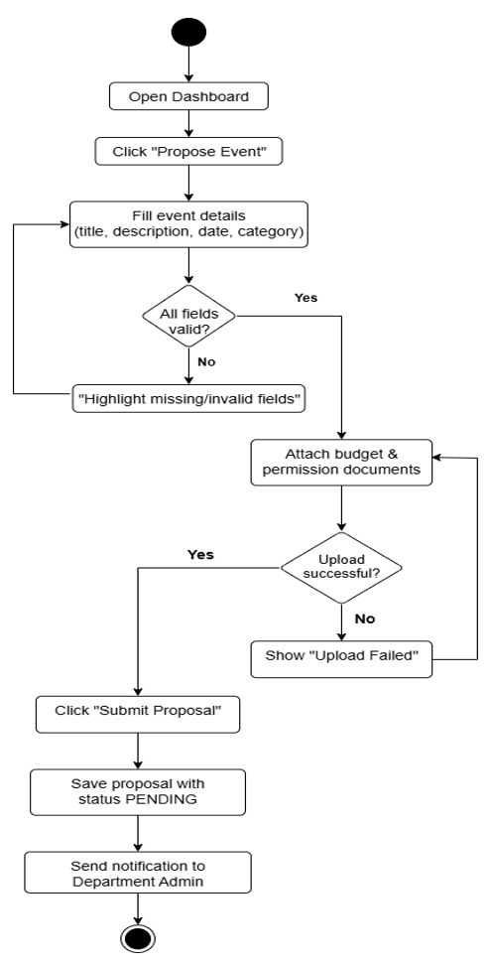
Activity Diagram - 03: Submit Event Proposal

Slide 15
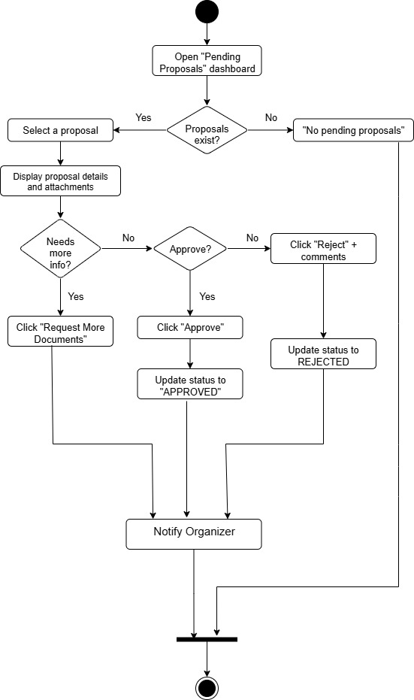
Activity Diagram - 04: Review & Approve Proposal

Slide 16
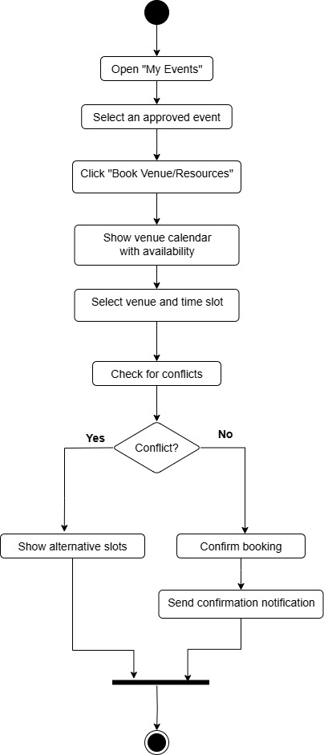
Activity Diagram - 05: Book Venue & Resources

Slide 17
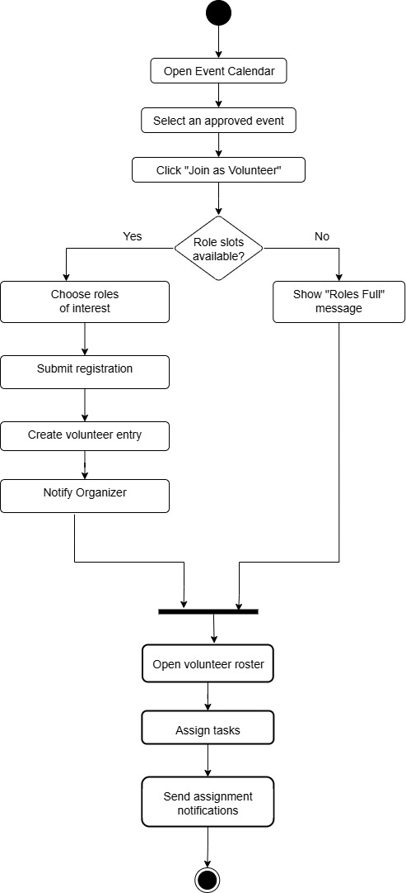
Activity Diagram - 06: Volunteer Registration & Assignment

Slide 18
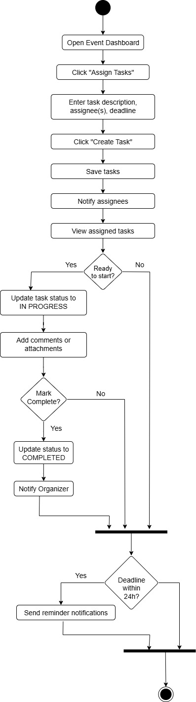
Activity Diagram - 07: Task Coordination & Progress Tracking

Slide 19
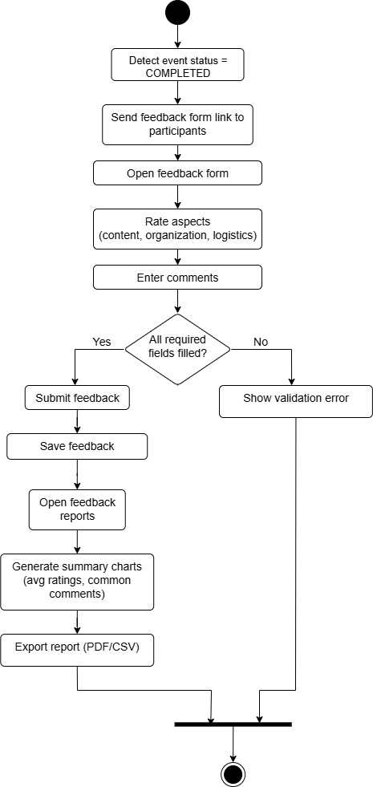
Activity Diagram - 08: Feedback Collection & Reporting

Slide 20
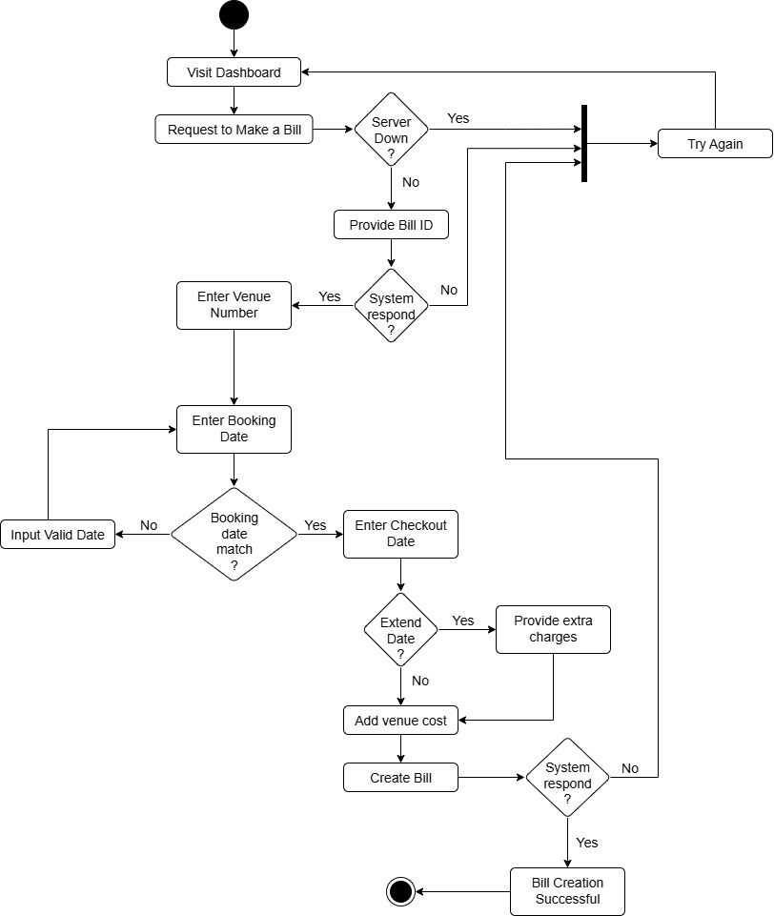
Activity Diagram - 09: Make a Bill

Slide 21
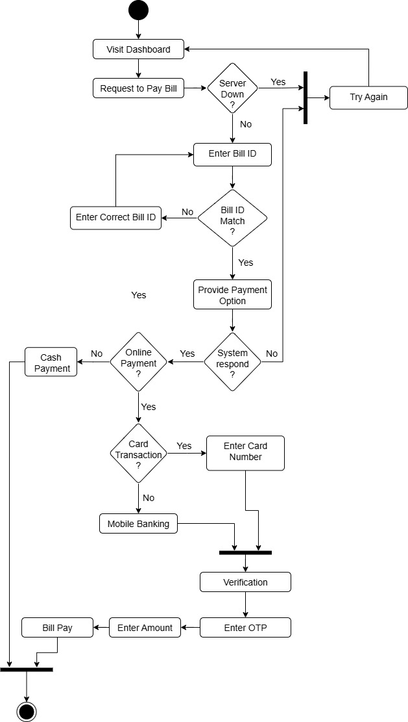
Activity Diagram - 10: Pay Bill

Slide 22
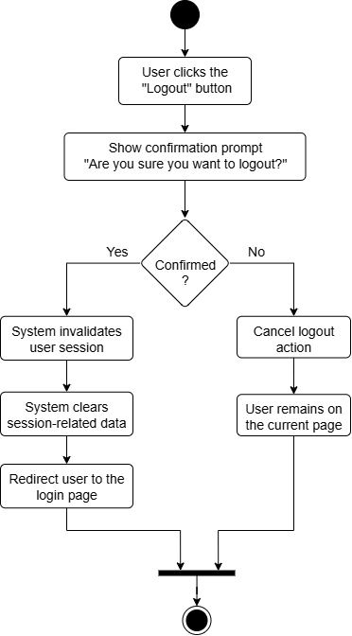
Activity Diagram - 11: Logout

Slide 23
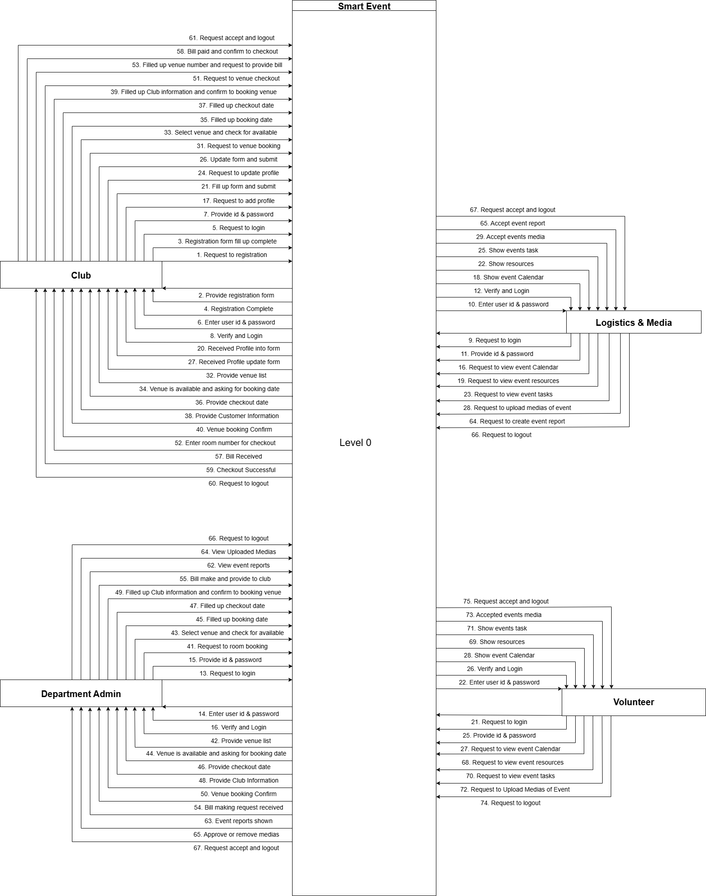
Data Flow Diagram: Level - 0

Slide 24
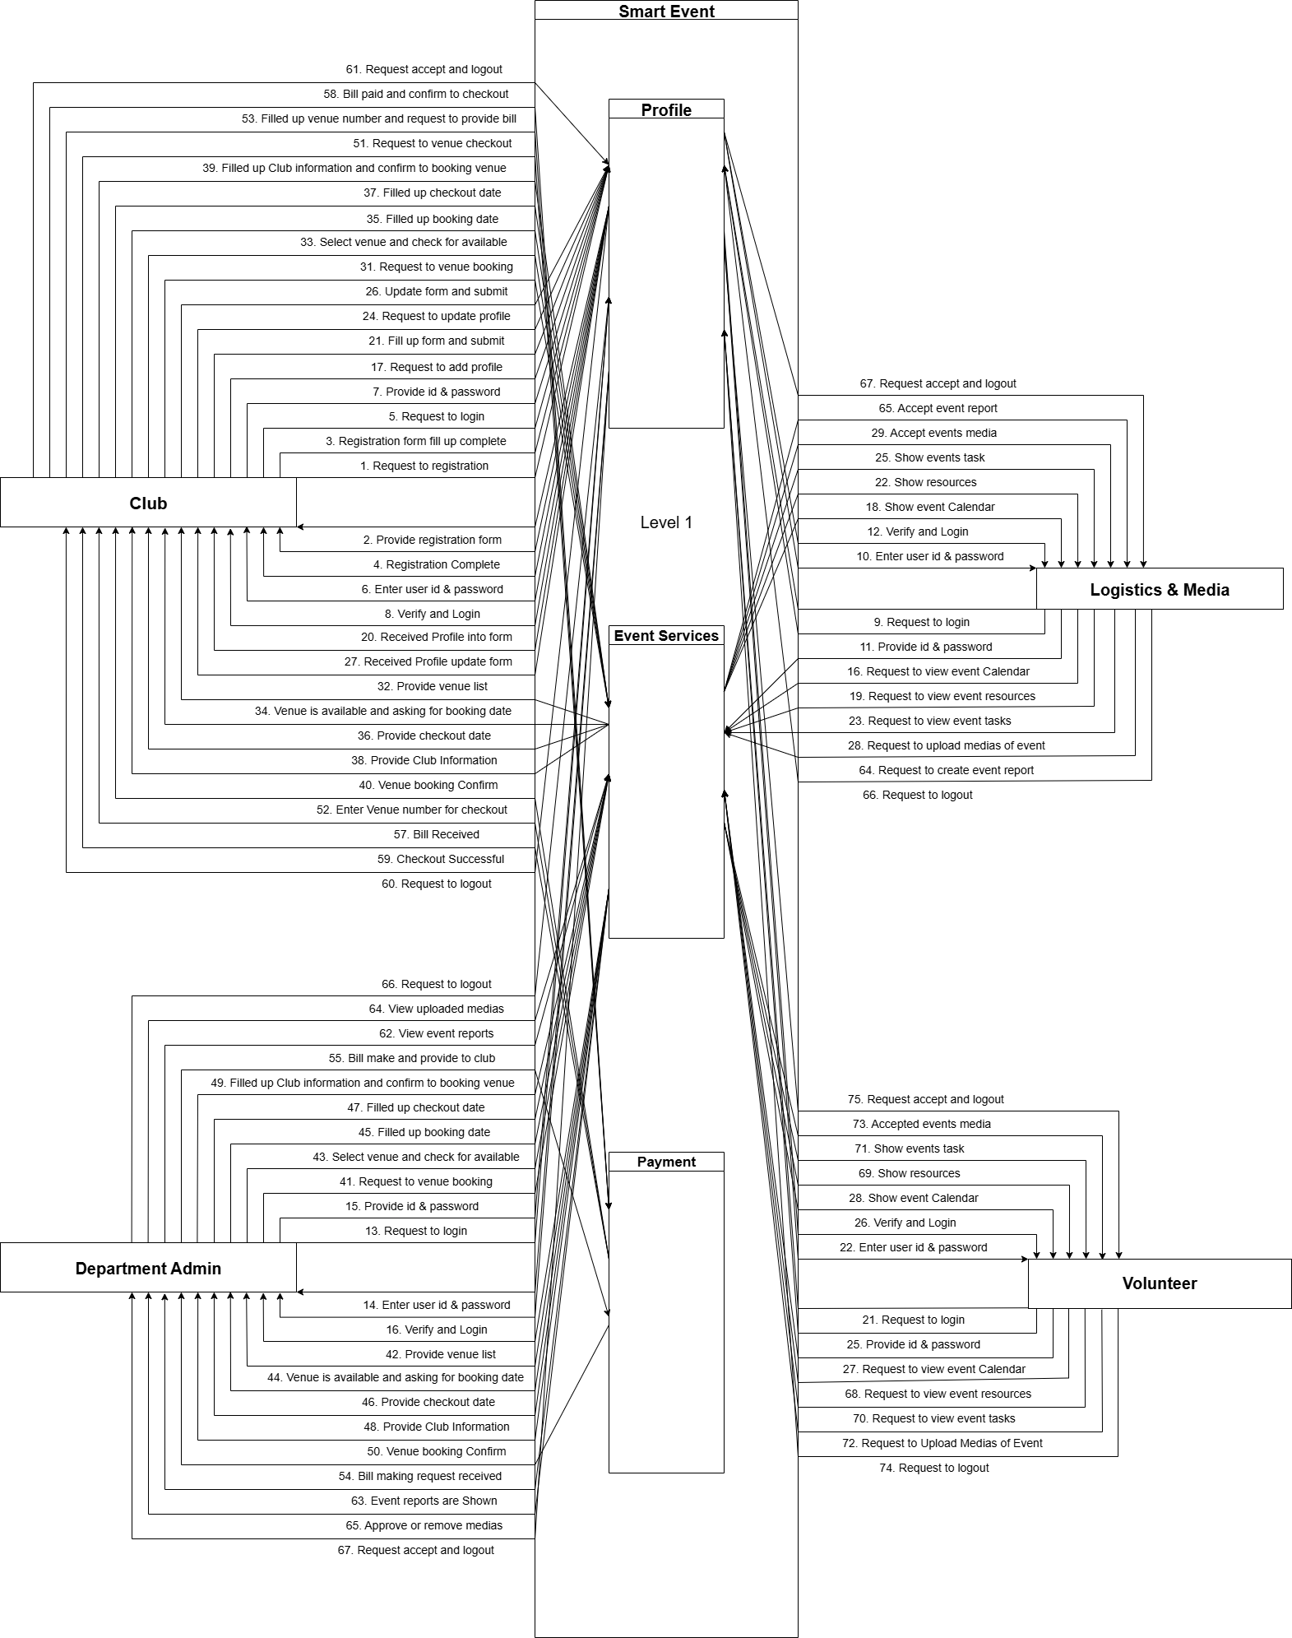
Data Flow Diagram: Level - 1

Slide 25
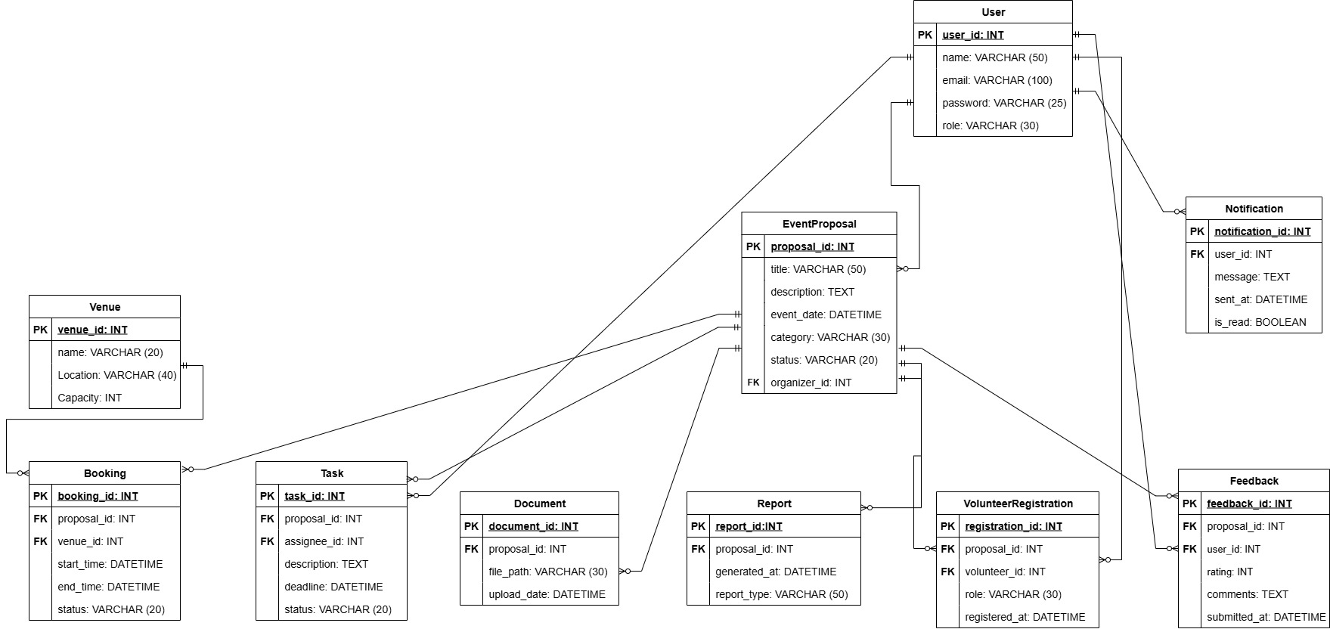
ER Diagram:

Slide 26
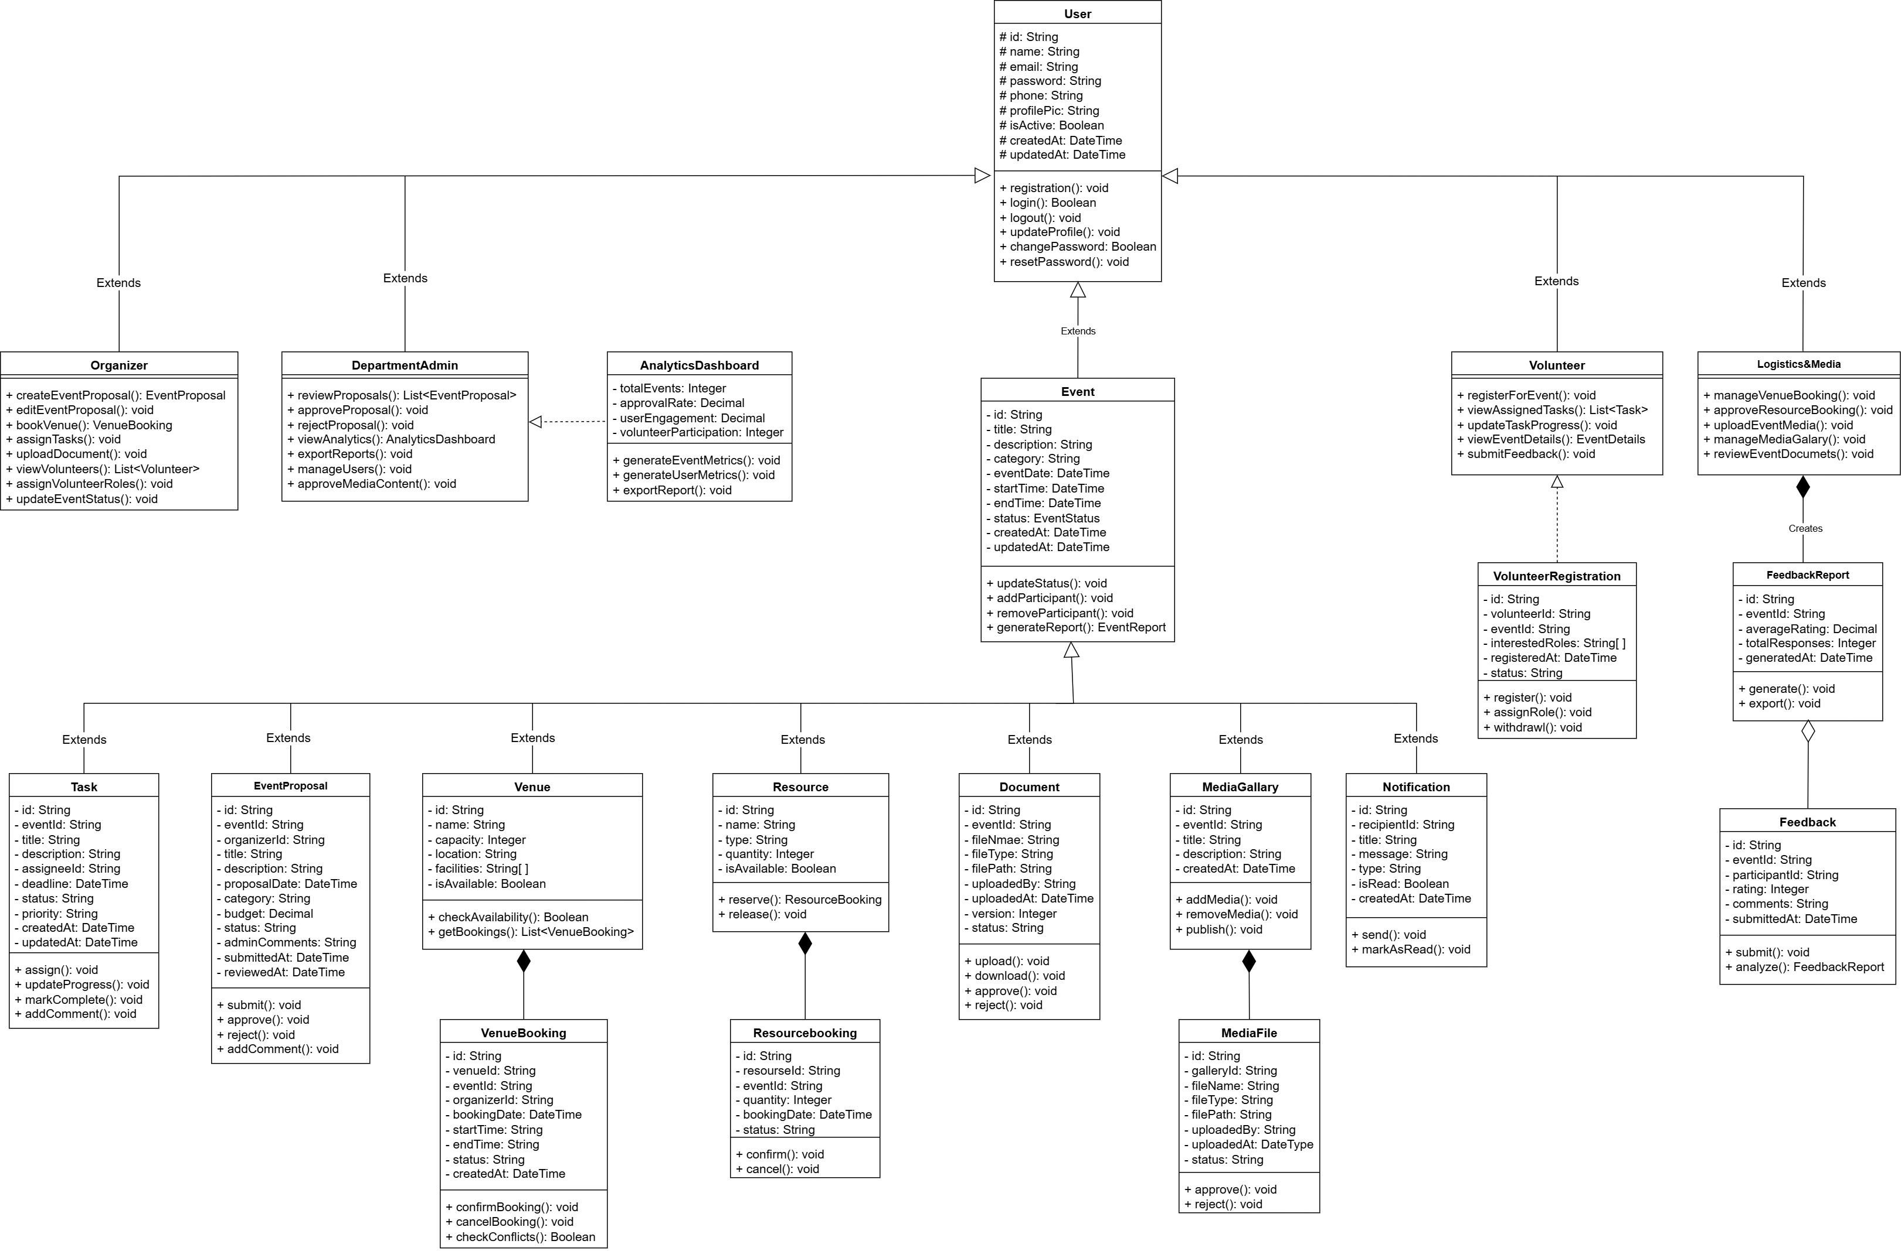
Class Diagram:

Slide 27
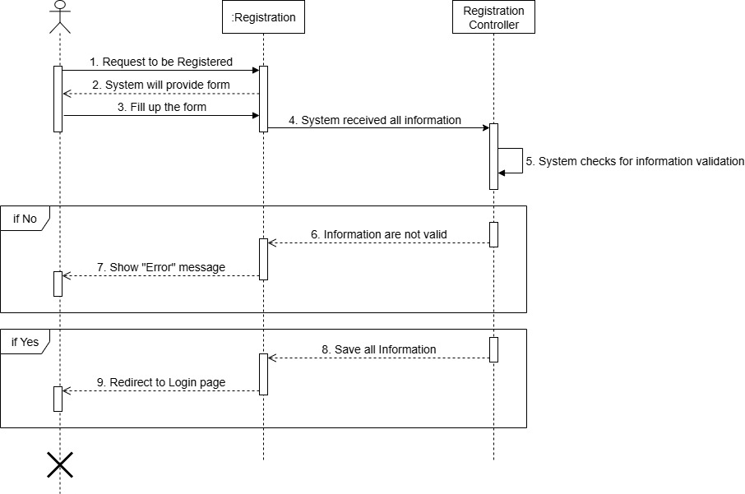
Sequence Diagram - 01: Registration

Slide 28
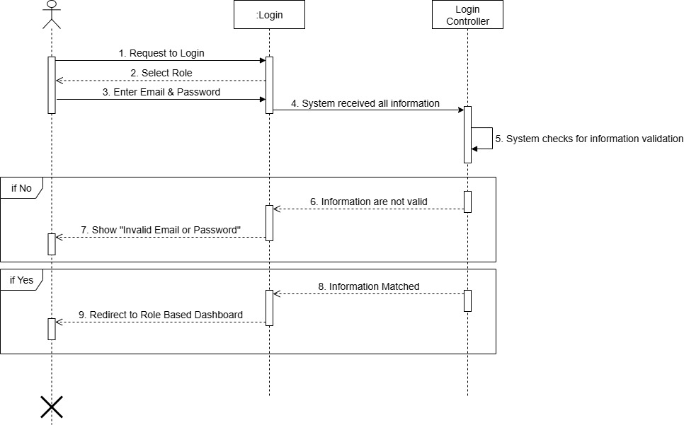
Sequence Diagram - 02: Login

Slide 29
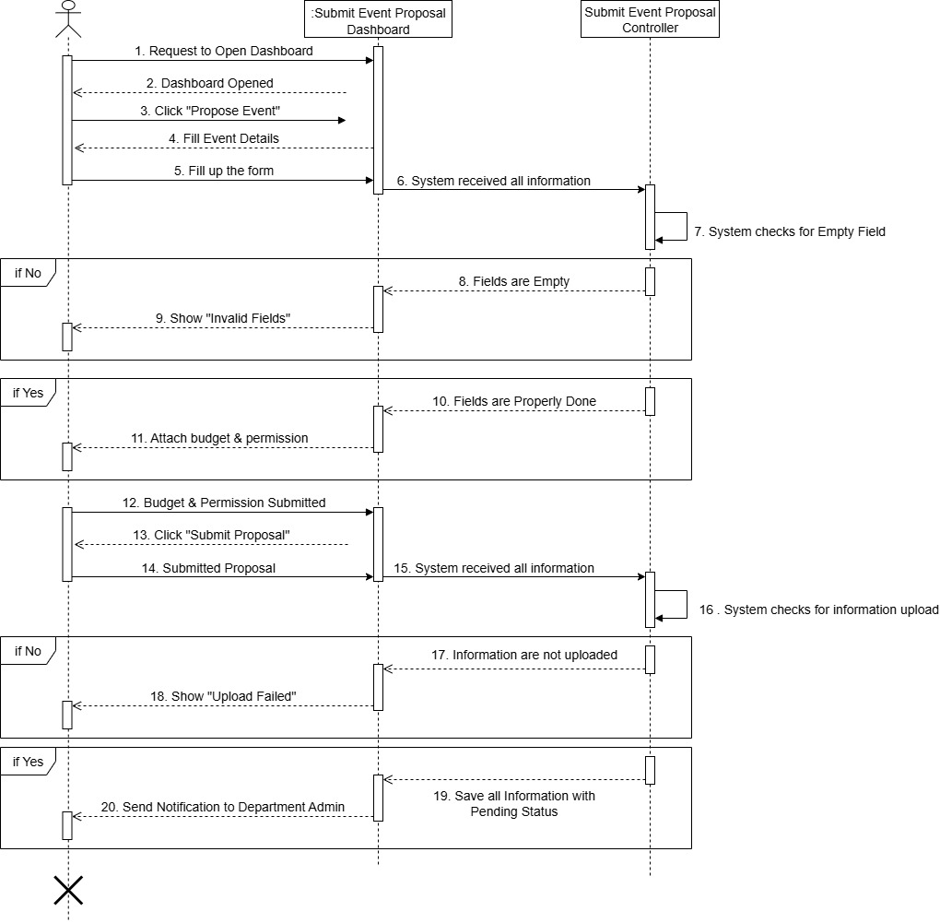
Sequence Diagram - 03: Submit Event Proposal

Slide 30
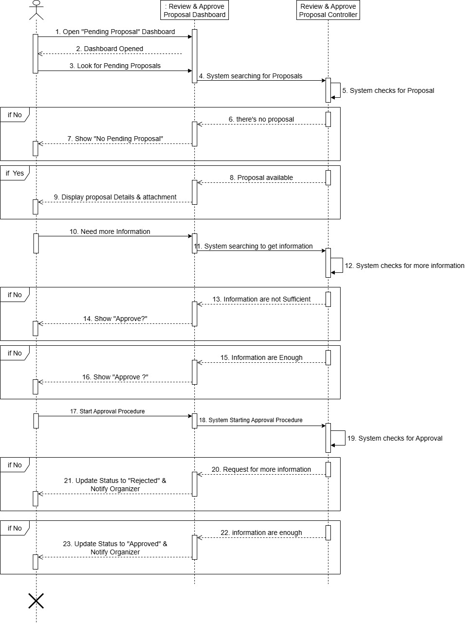
Sequence Diagram - 04: Review & Approve Proposal

Slide 31
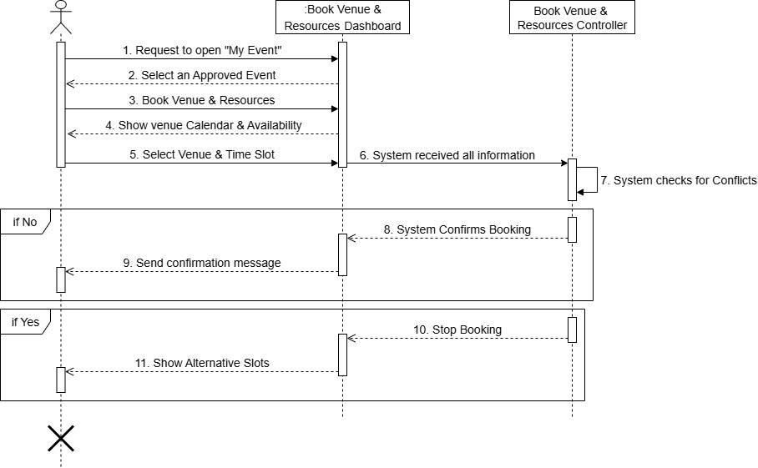
Sequence Diagram - 05: Book Venue & Resources

Slide 32
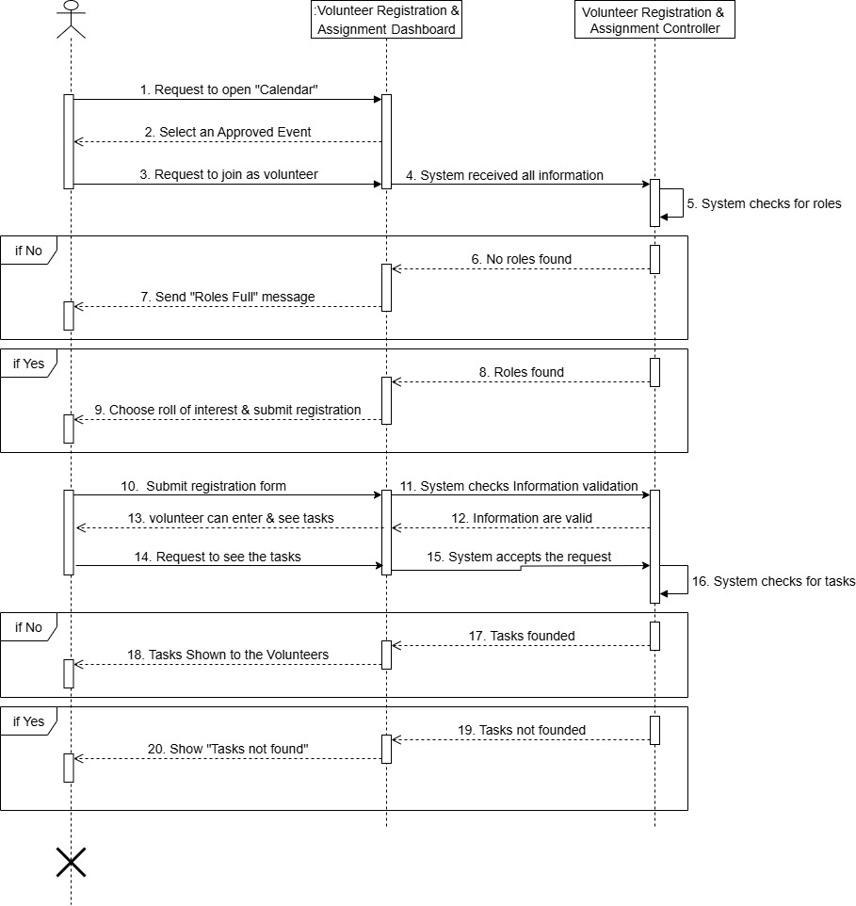
Sequence Diagram - 06: Volunteer Registration & Assignment

Slide 33
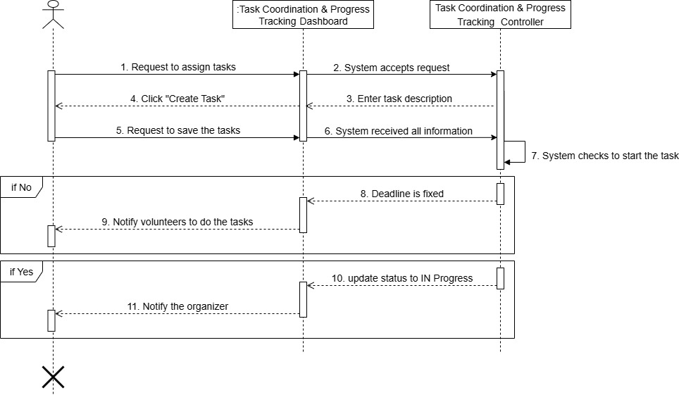
Sequence Diagram - 07: Task Coordination & Progress Tracking

Slide 34
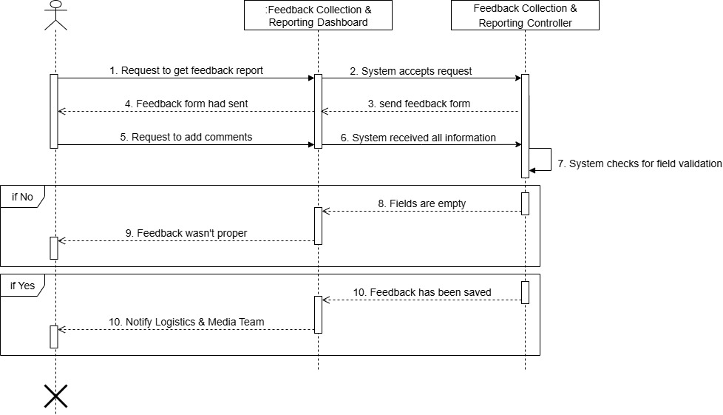
Sequence Diagram - 08: Feedback Collection & Reporting

Slide 35
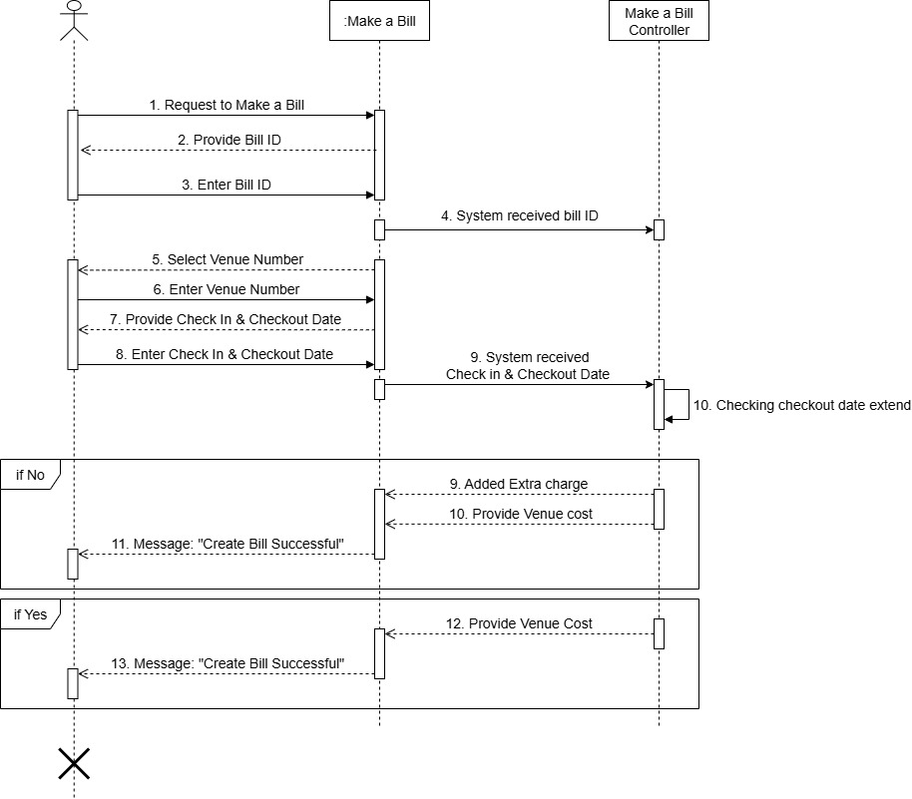
Sequence Diagram - 09 : Make a Bill

Slide 36
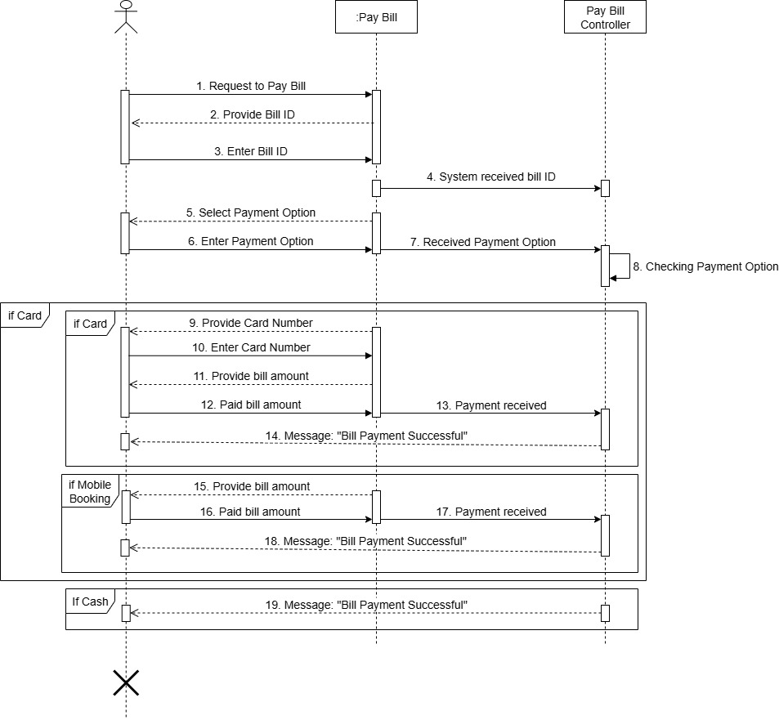
Sequence Diagram - 10: Pay Bill

Slide 37
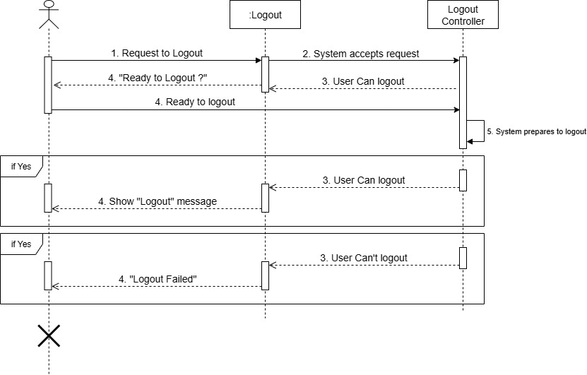
Sequence Diagram - 11: Logout

Slide 38
Project Visualization

Slide 39
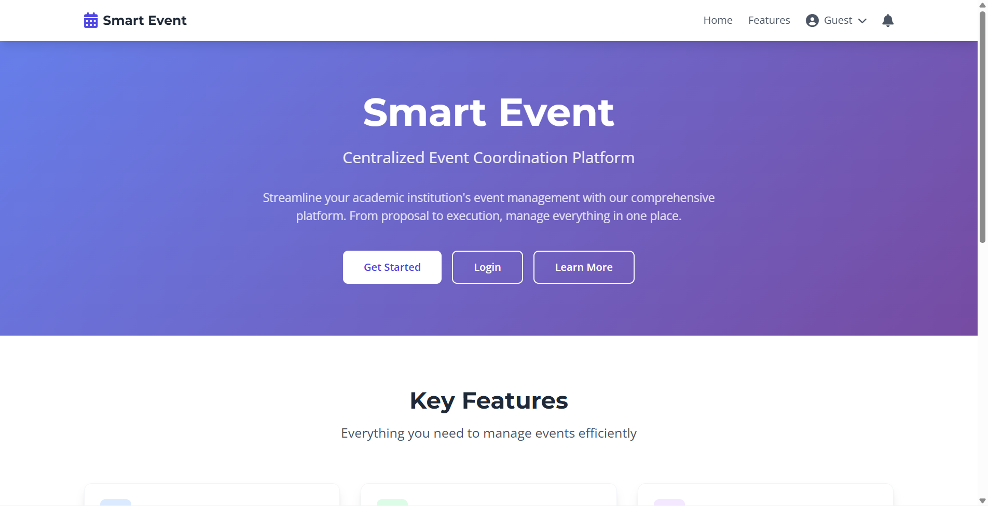

Slide 40
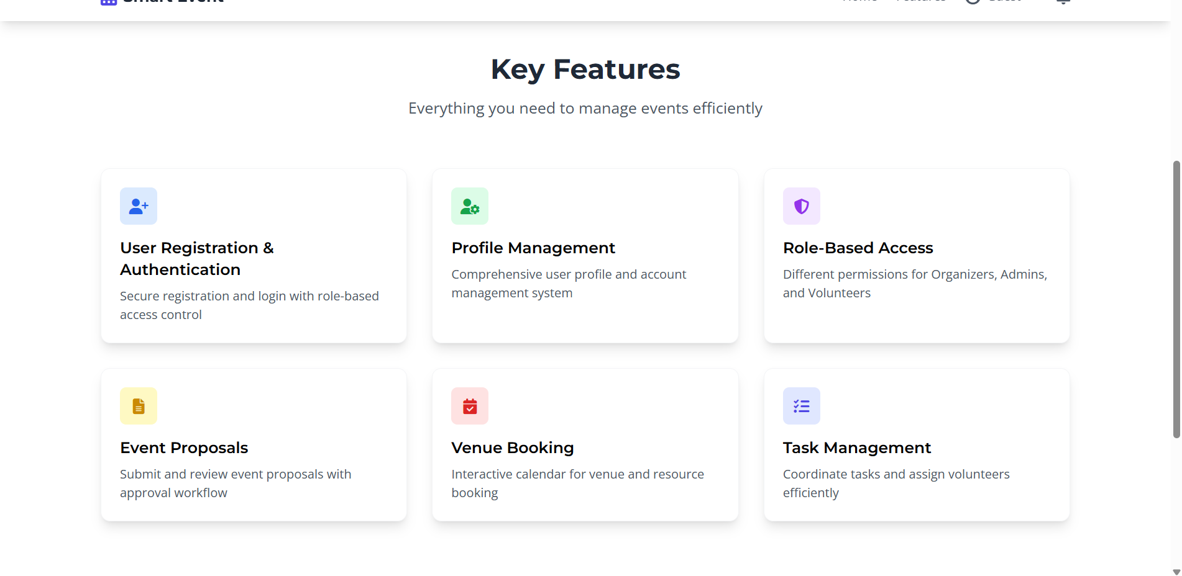

Slide 41
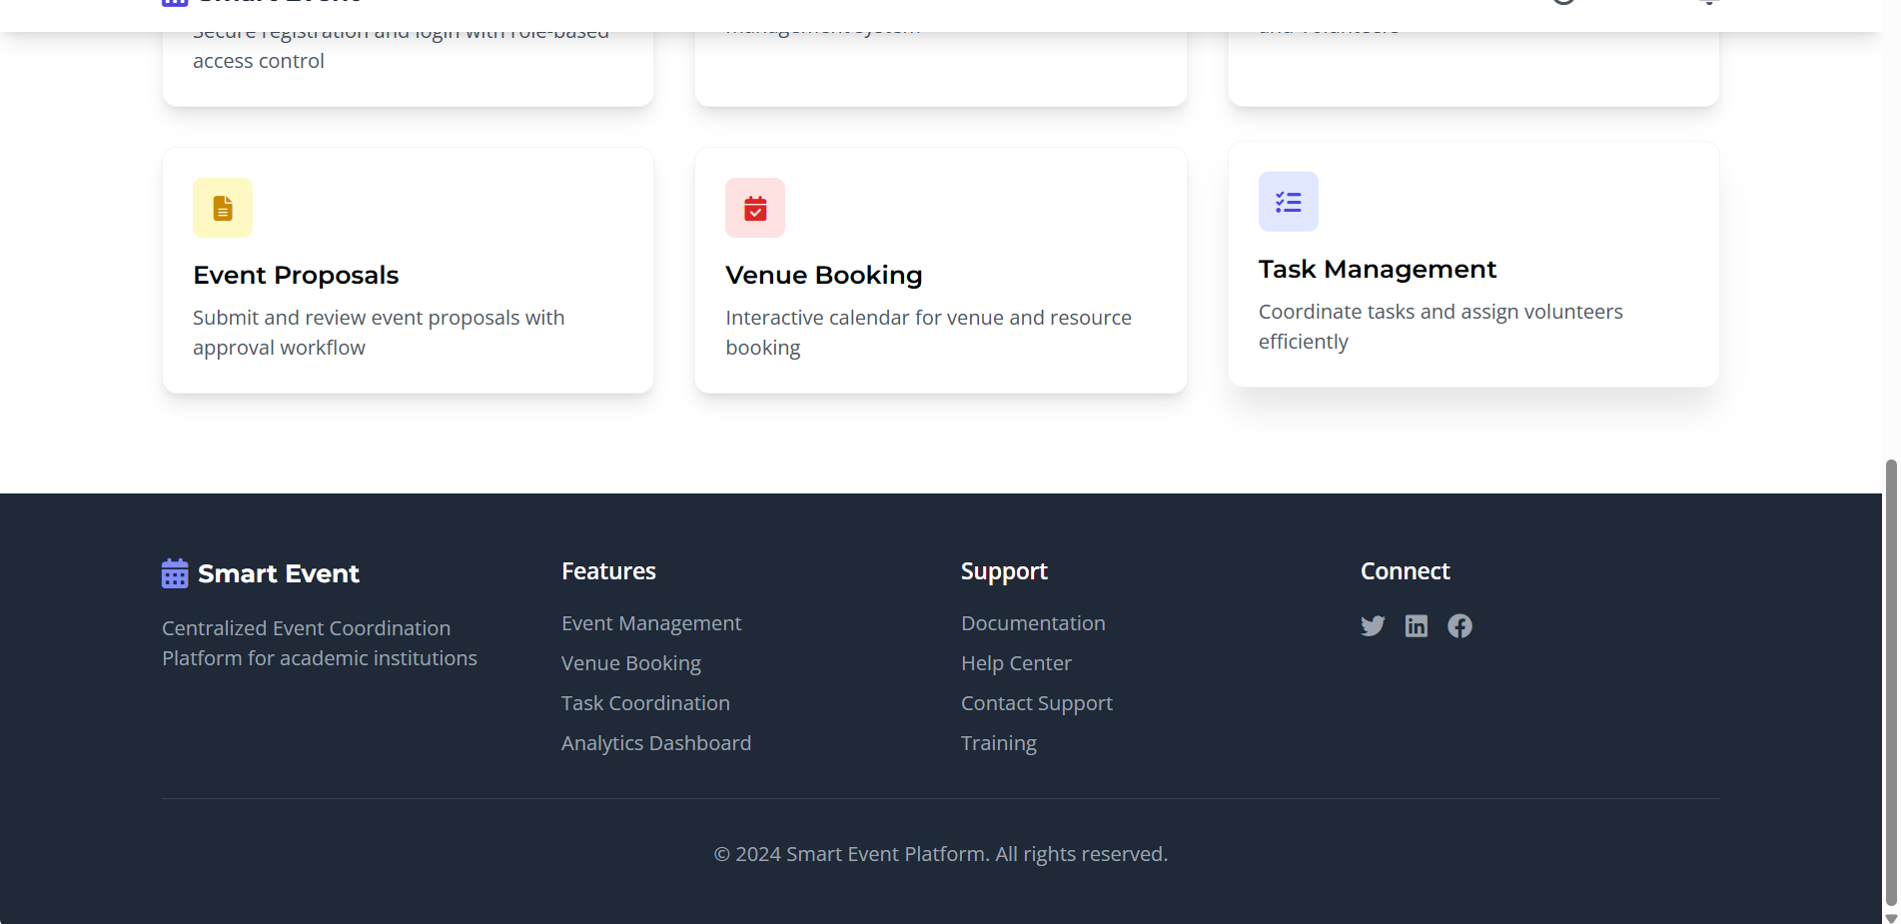

Slide 42
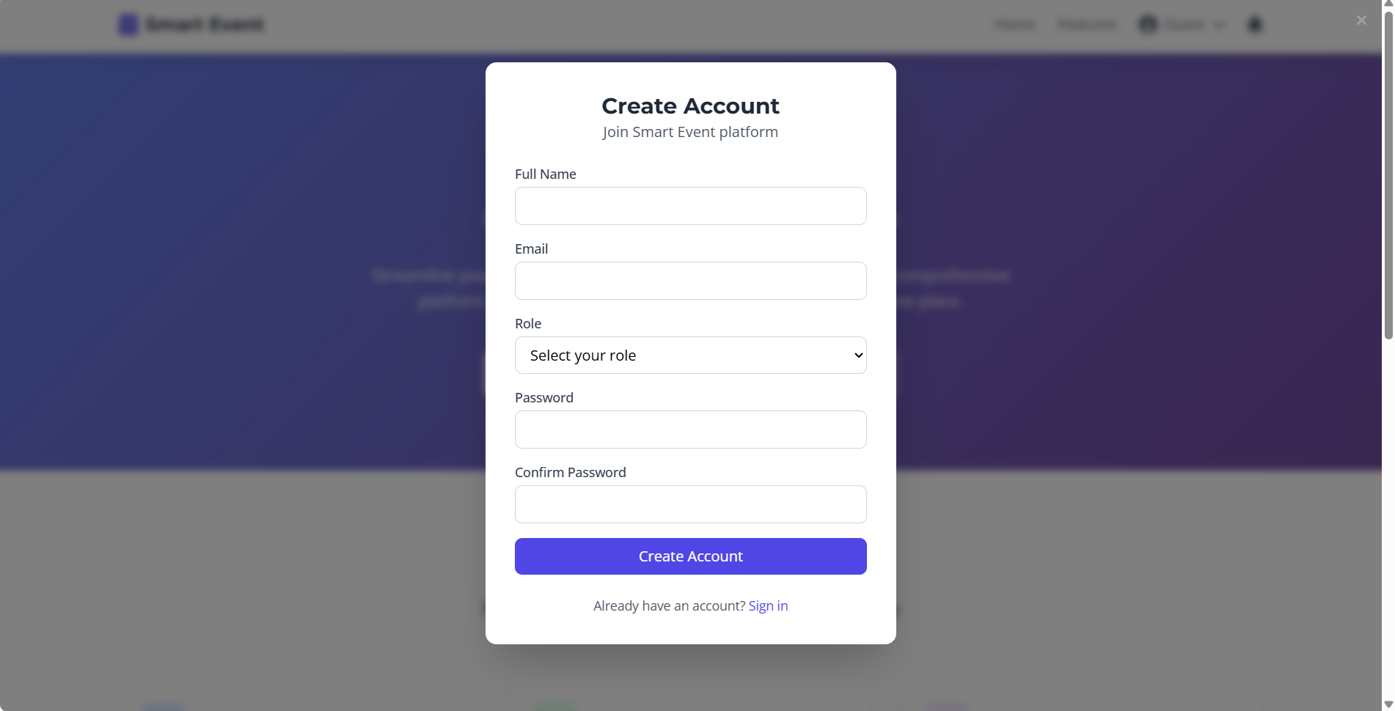

Slide 43
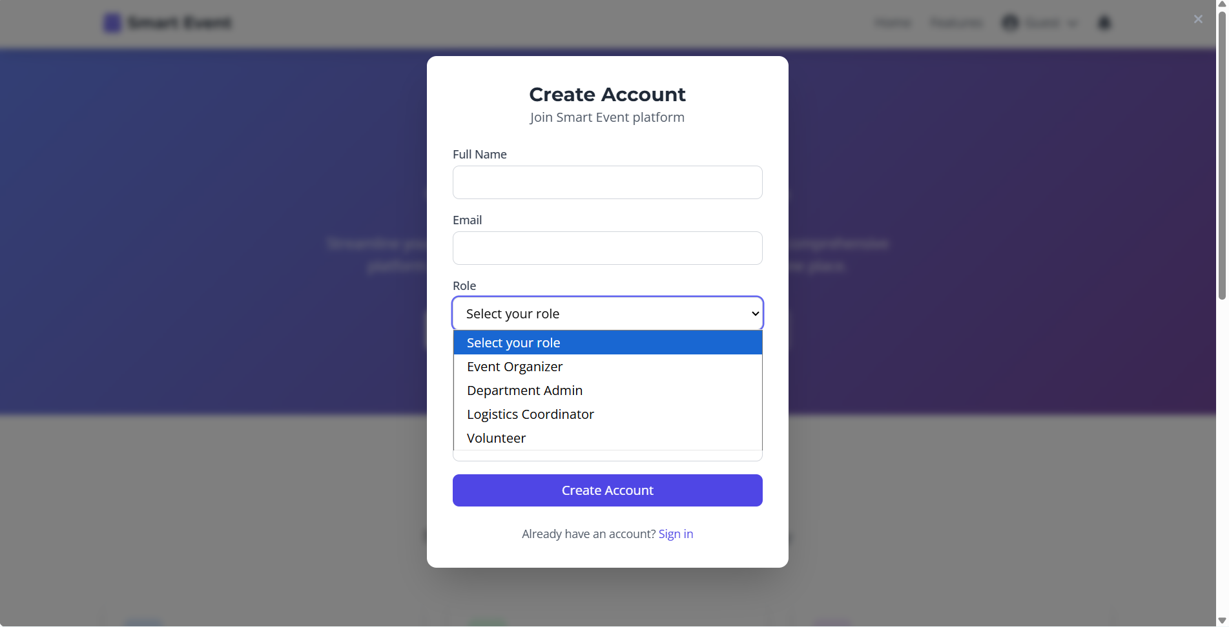

Slide 44
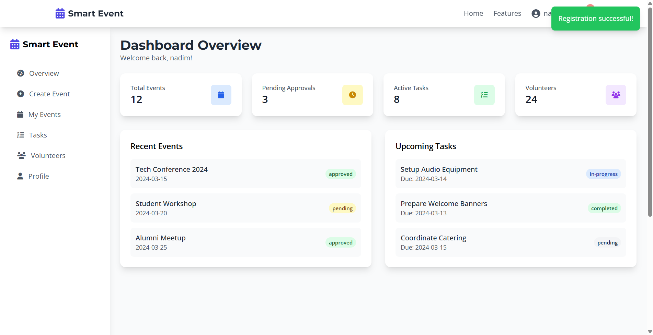

Slide 45
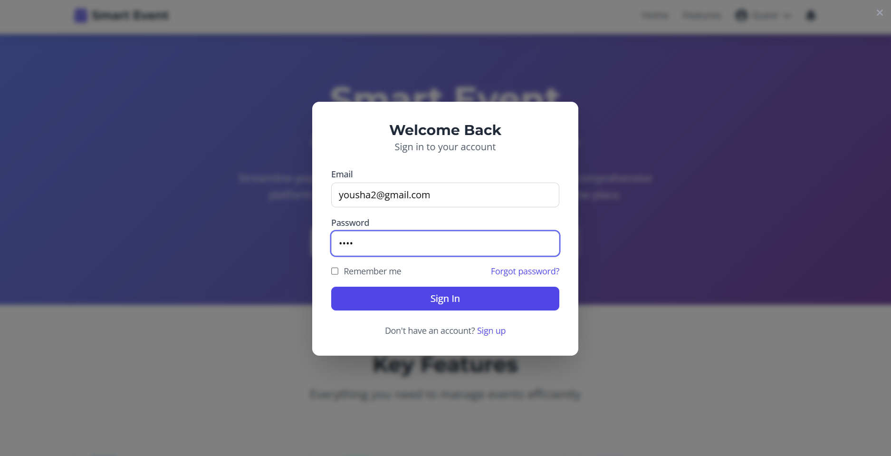

Slide 46
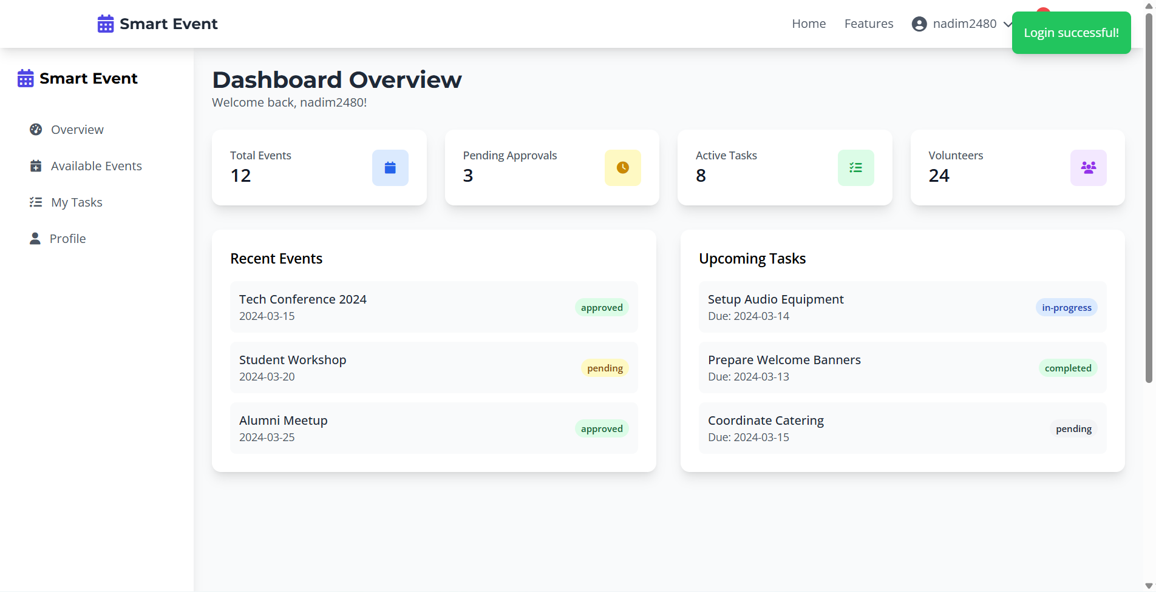

Slide 47
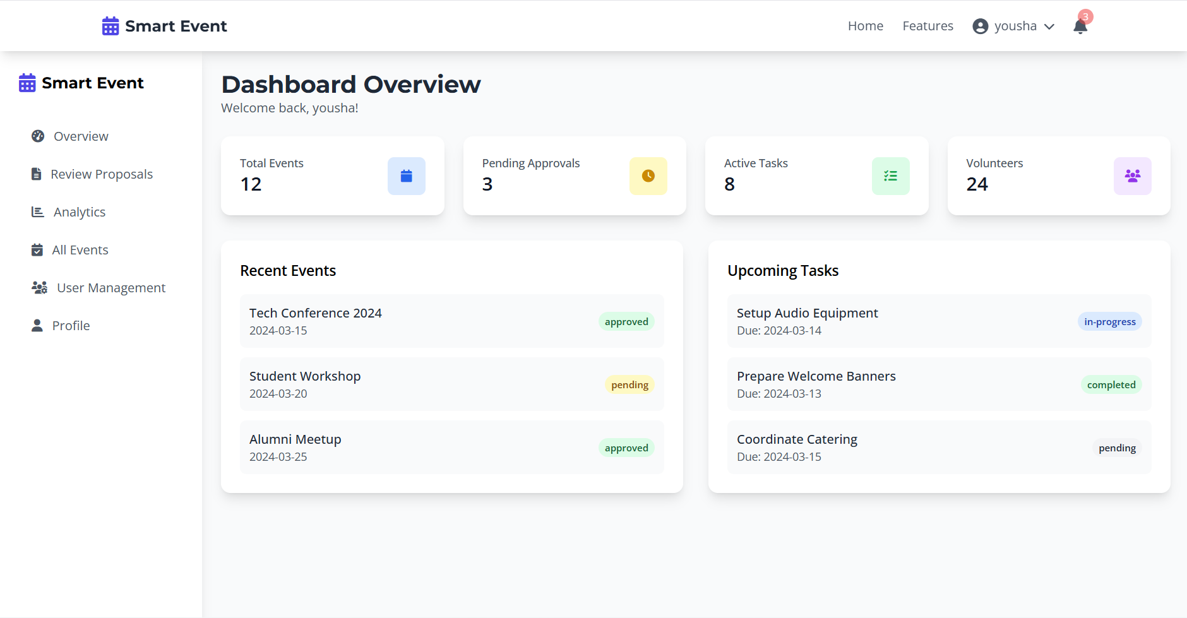

Slide 48
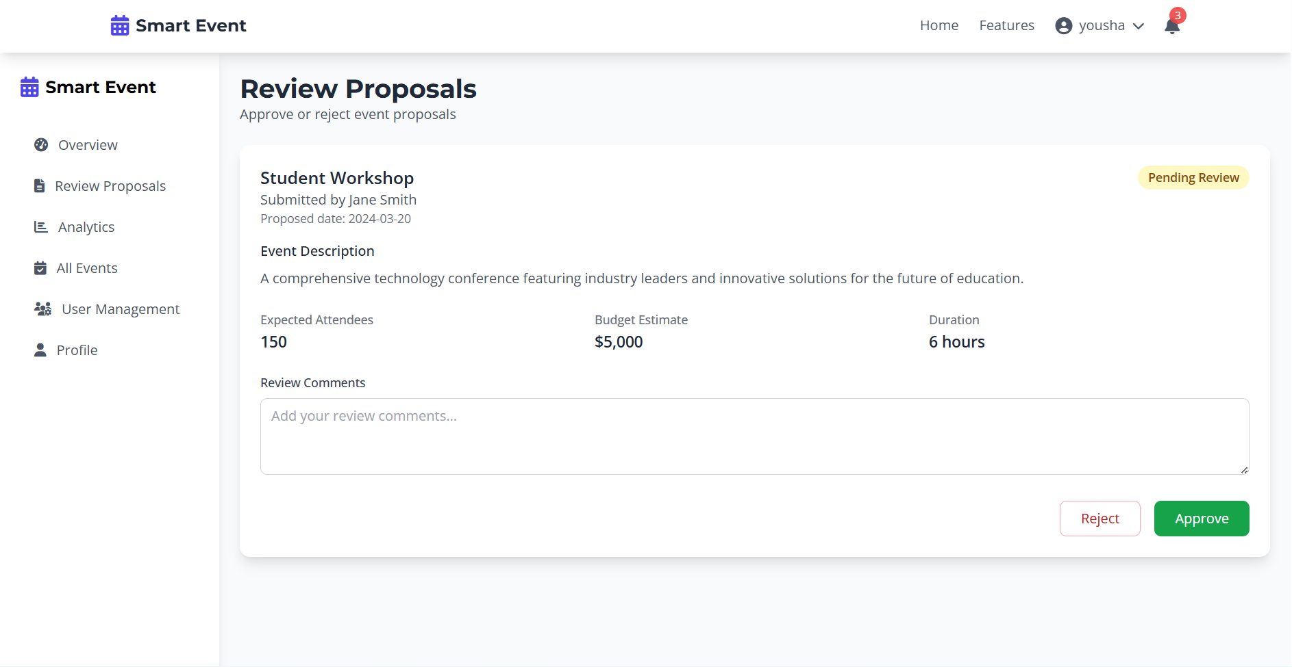

Slide 49
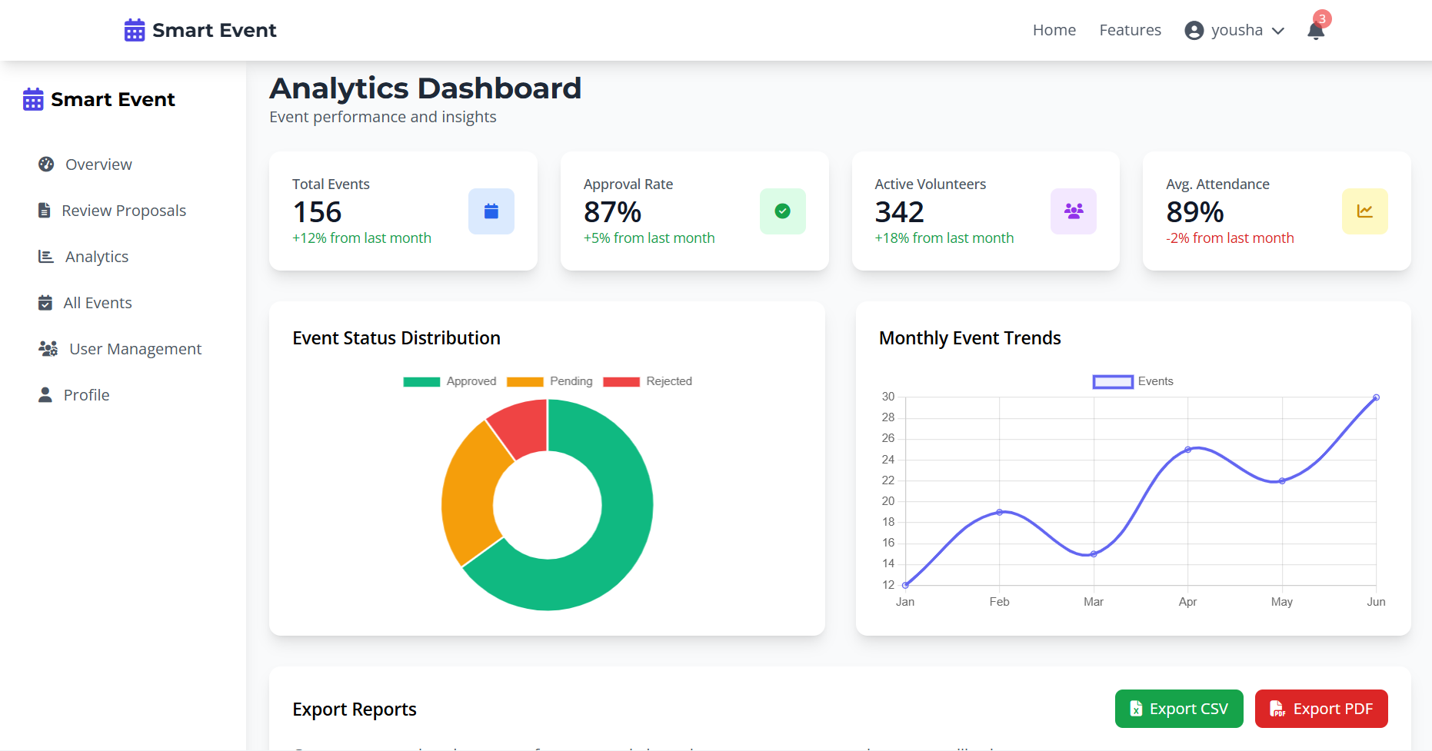

Slide 50
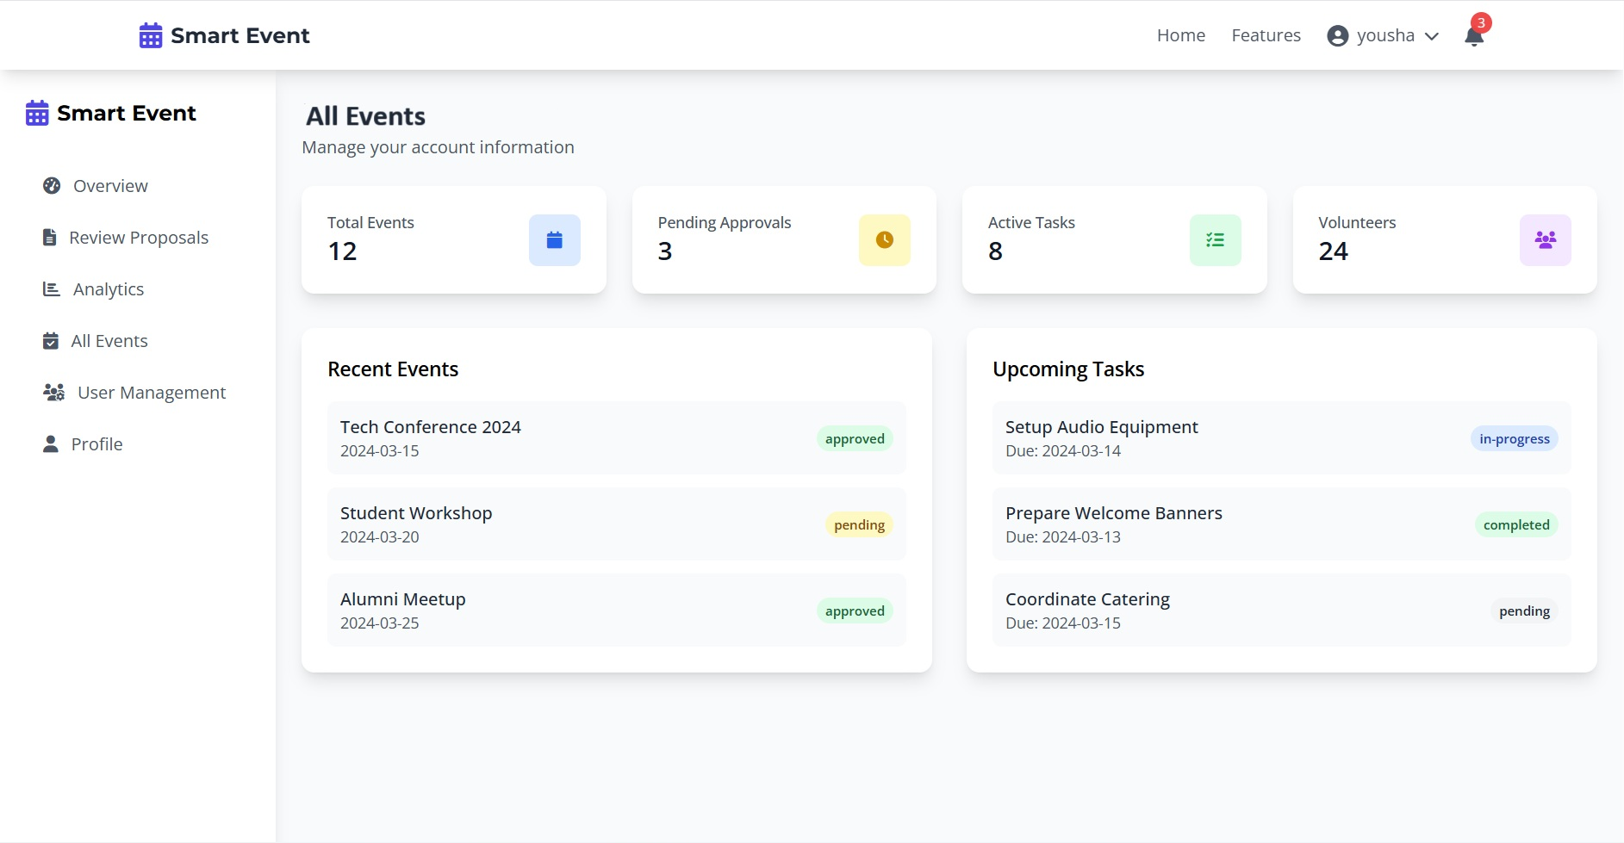

Slide 51
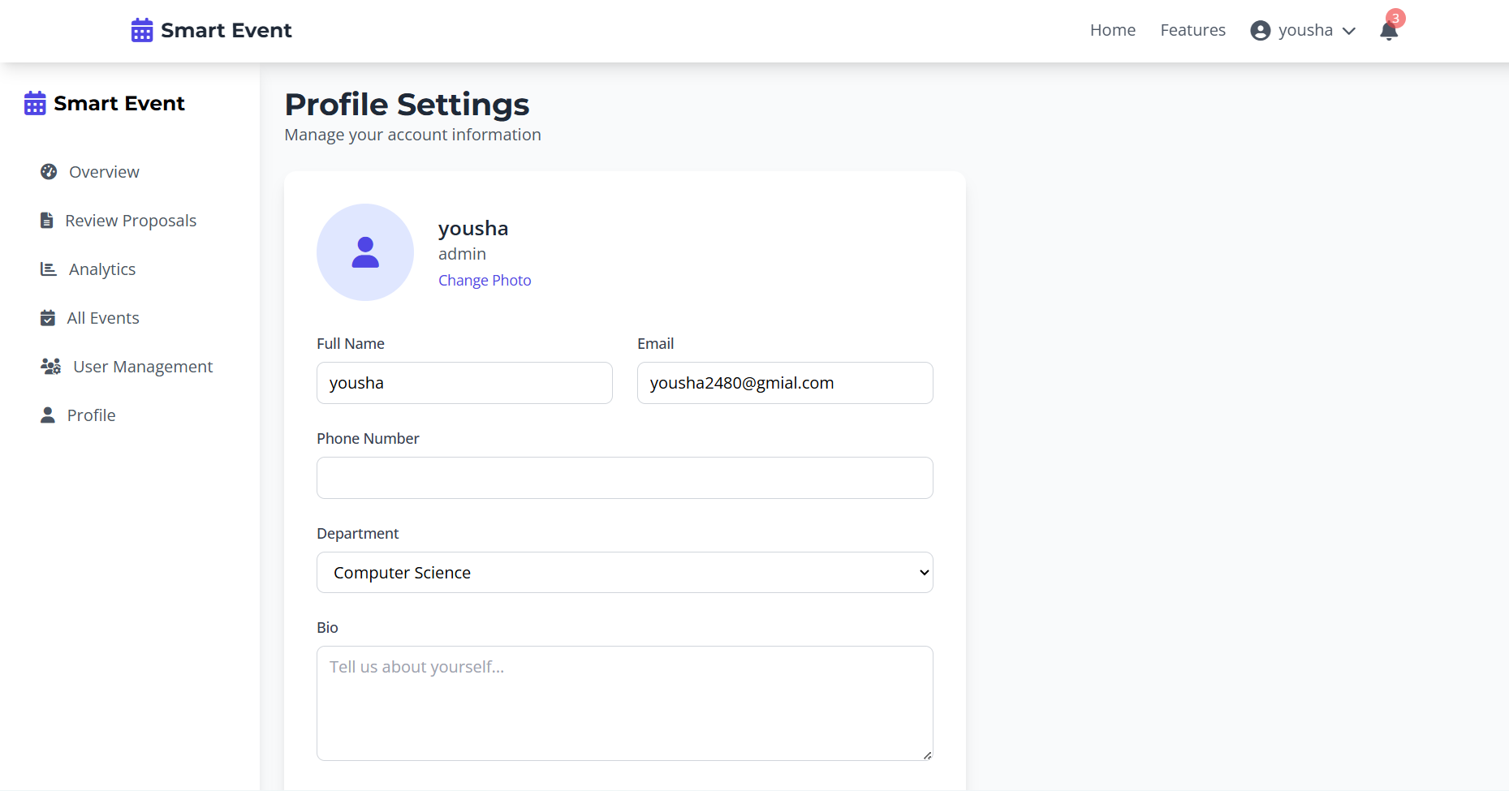

Slide 52
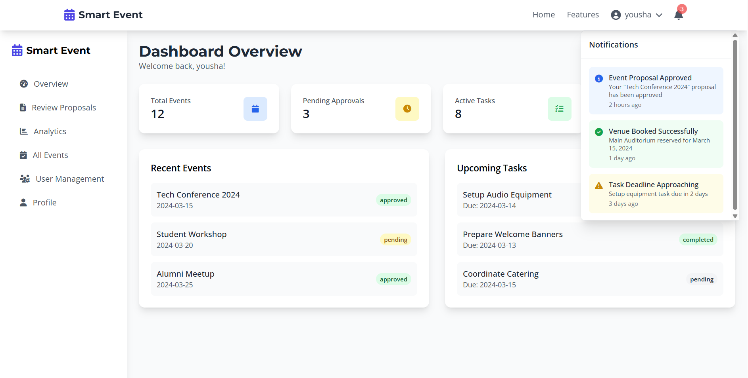

Slide 53
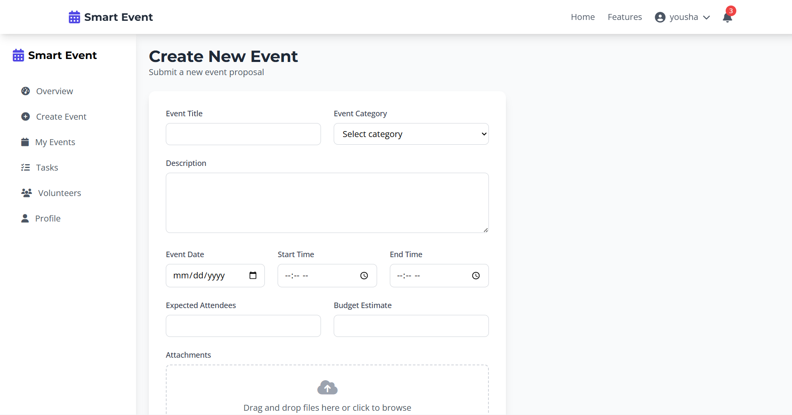

Slide 54
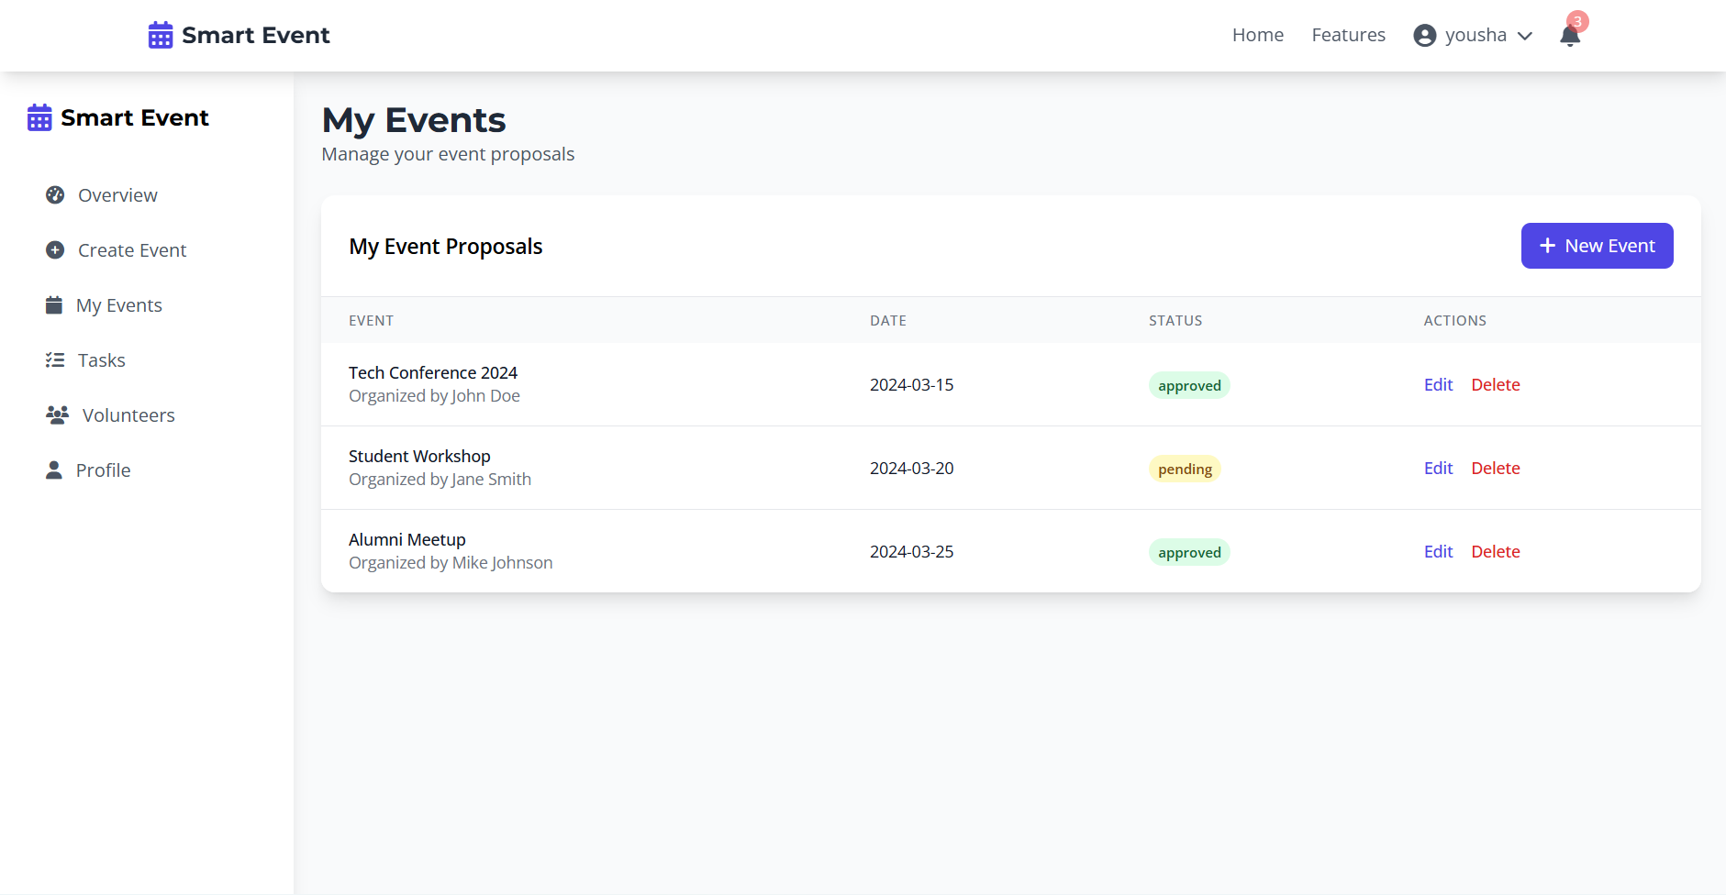

Slide 55
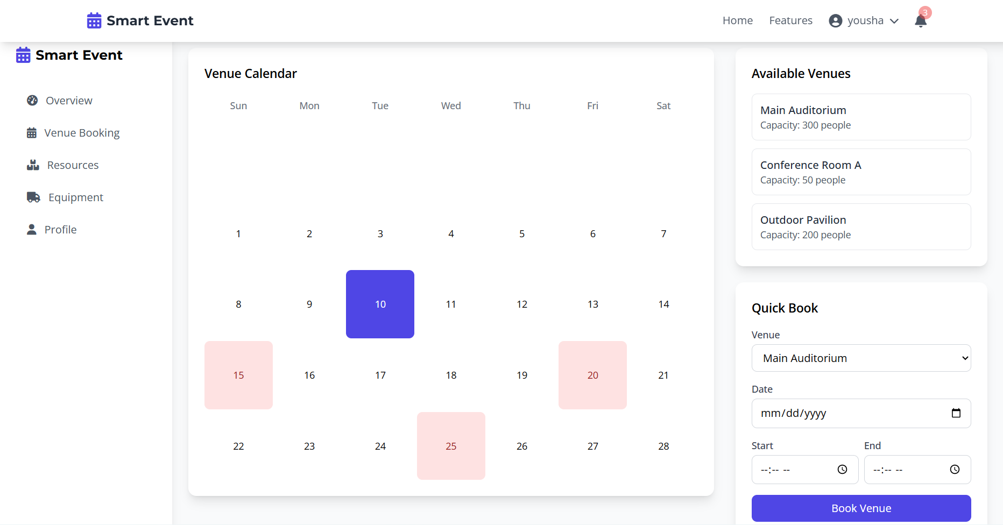

Slide 56
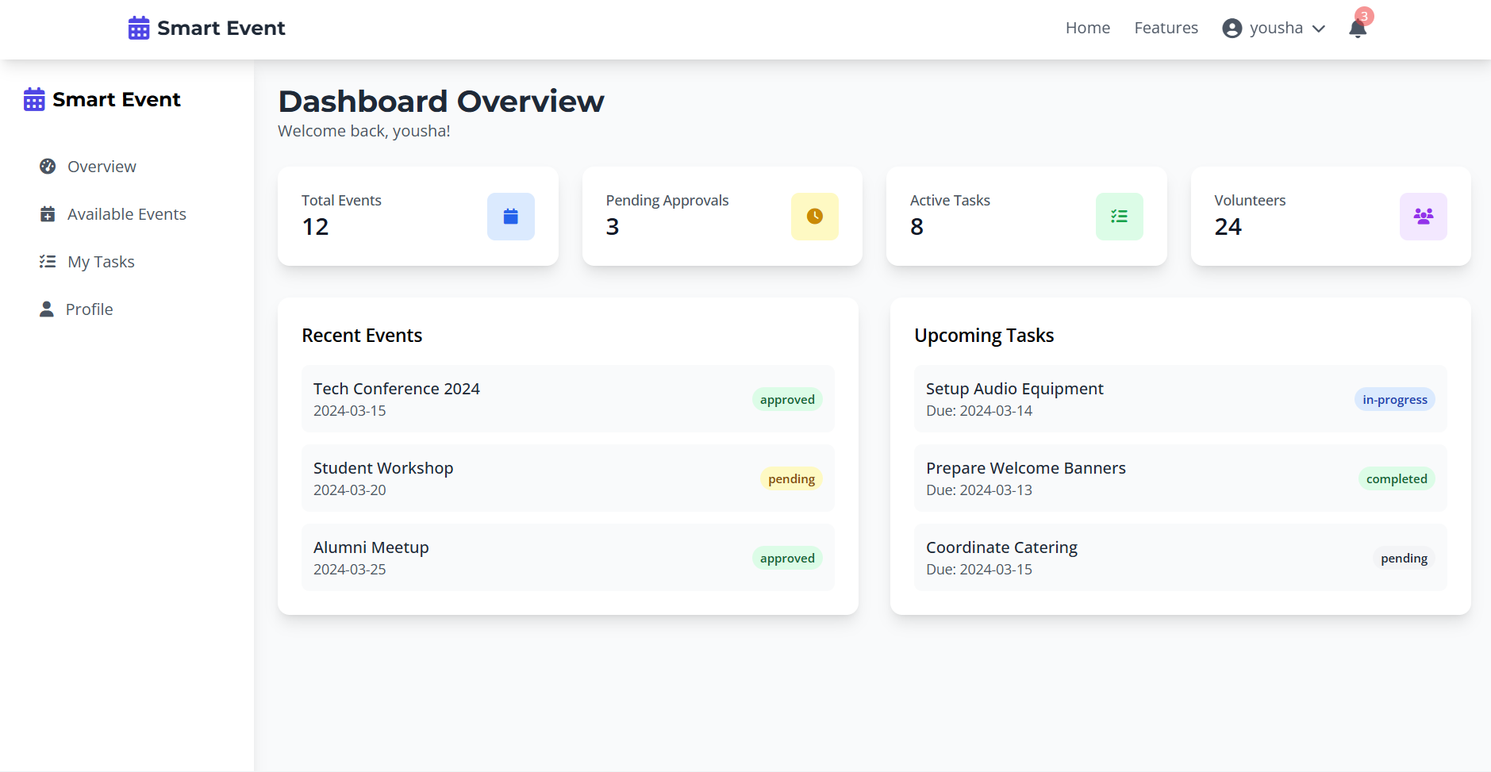

Slide 57
Thanks!
Do you have any Question?

